Slide 1
Competition: 2nd Session
11 July 2012, Wednesday

Slide 2
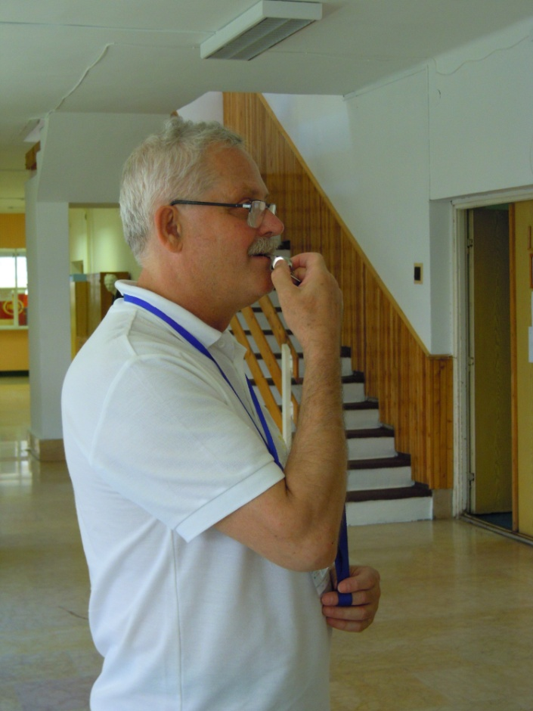
Start

Slide 3
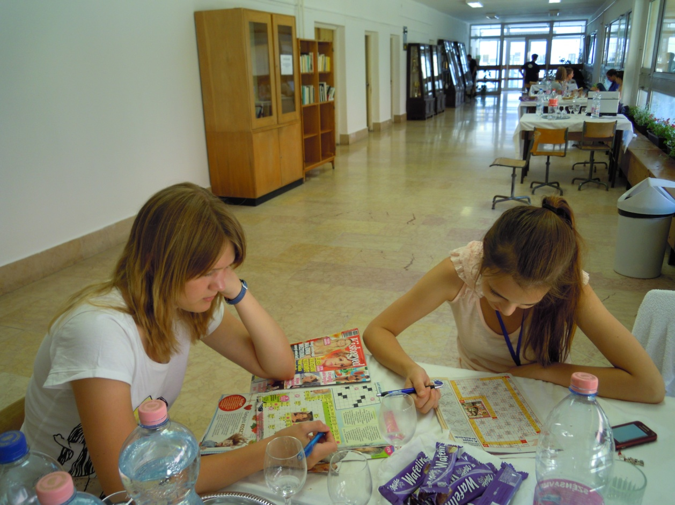
Guides

Slide 4
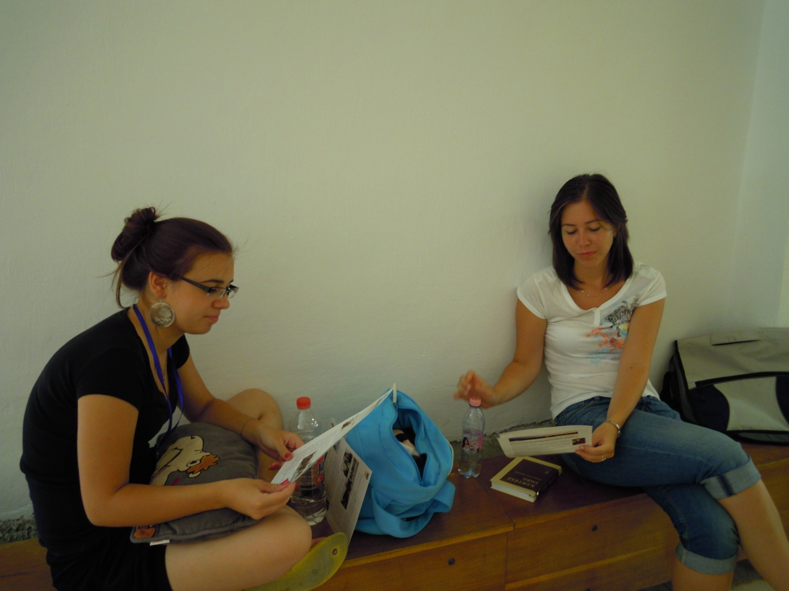
Waiting…

Slide 5
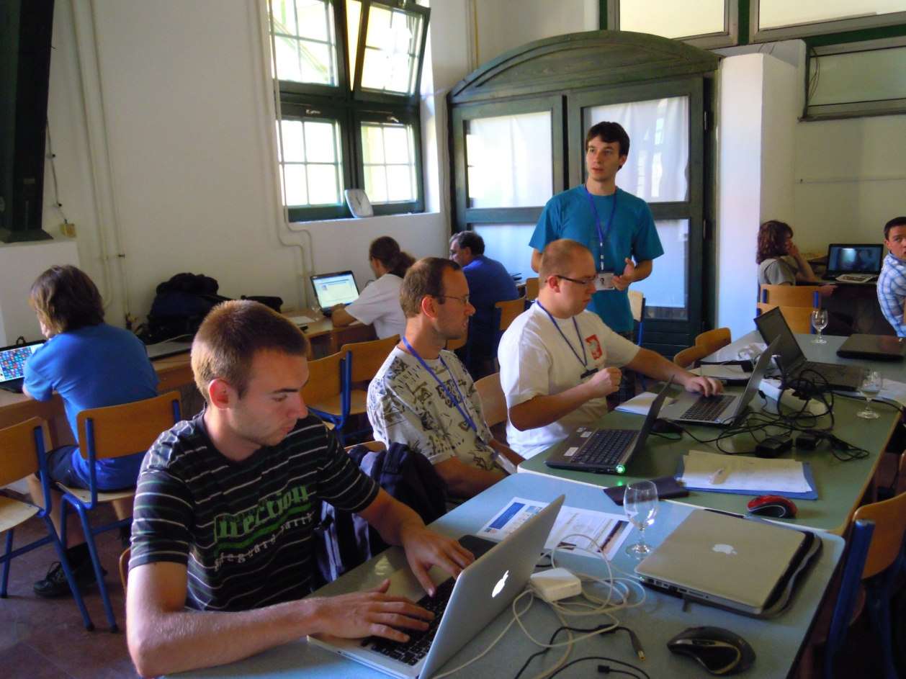
Waiting for the results

Slide 6
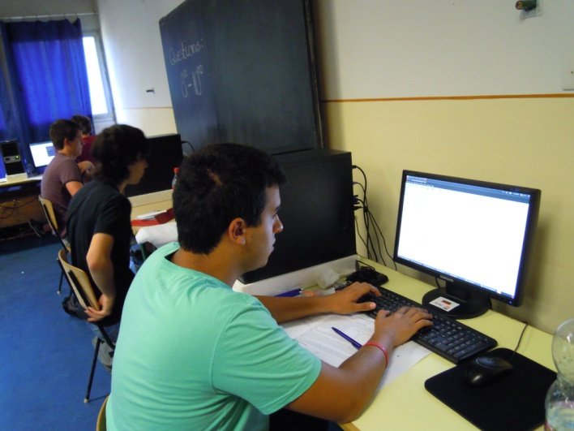
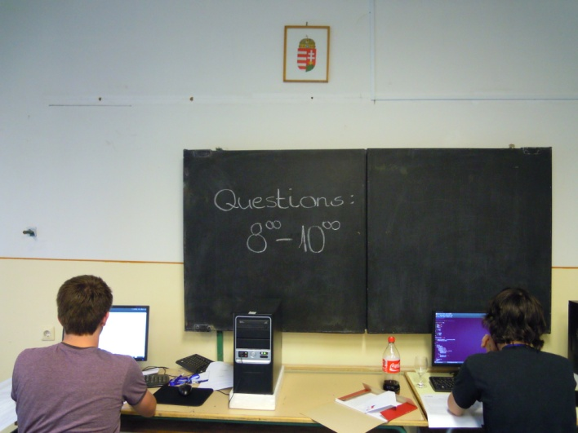
During Work

Slide 7
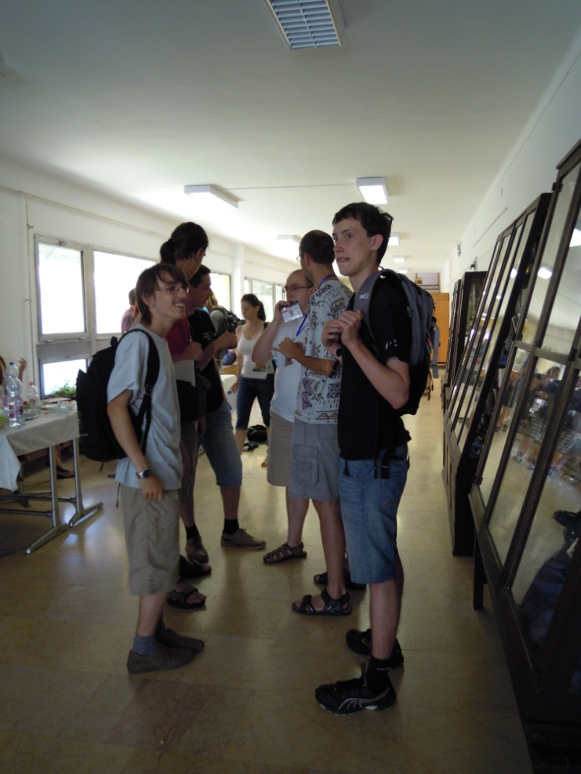
After the competition

Slide 8
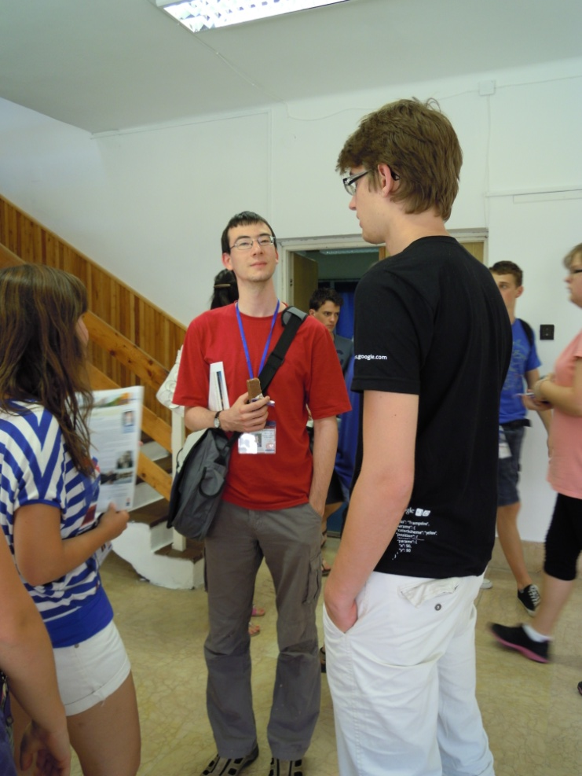
Exchanging information

Slide 9
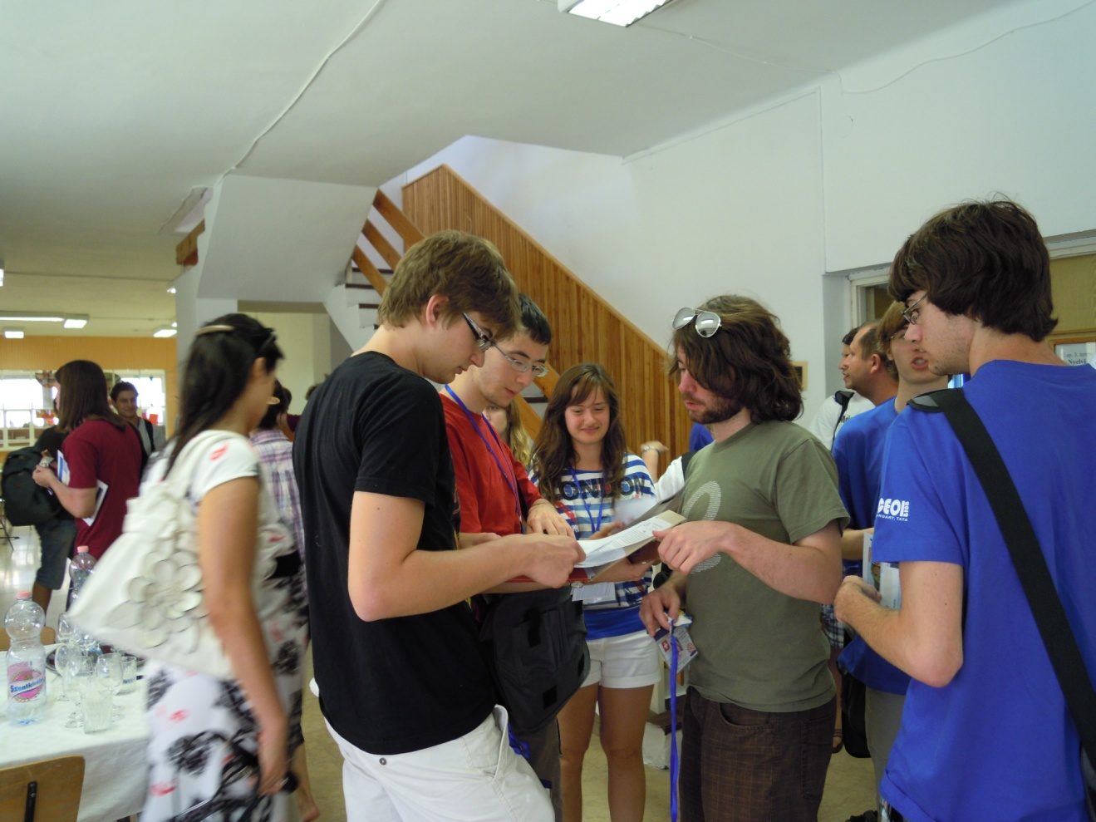
Exchanging information

Slide 10
Statistics

Slide 11
Statistics

Slide 12
Fort of Tata
11 July 2012, Wednesday

Slide 13
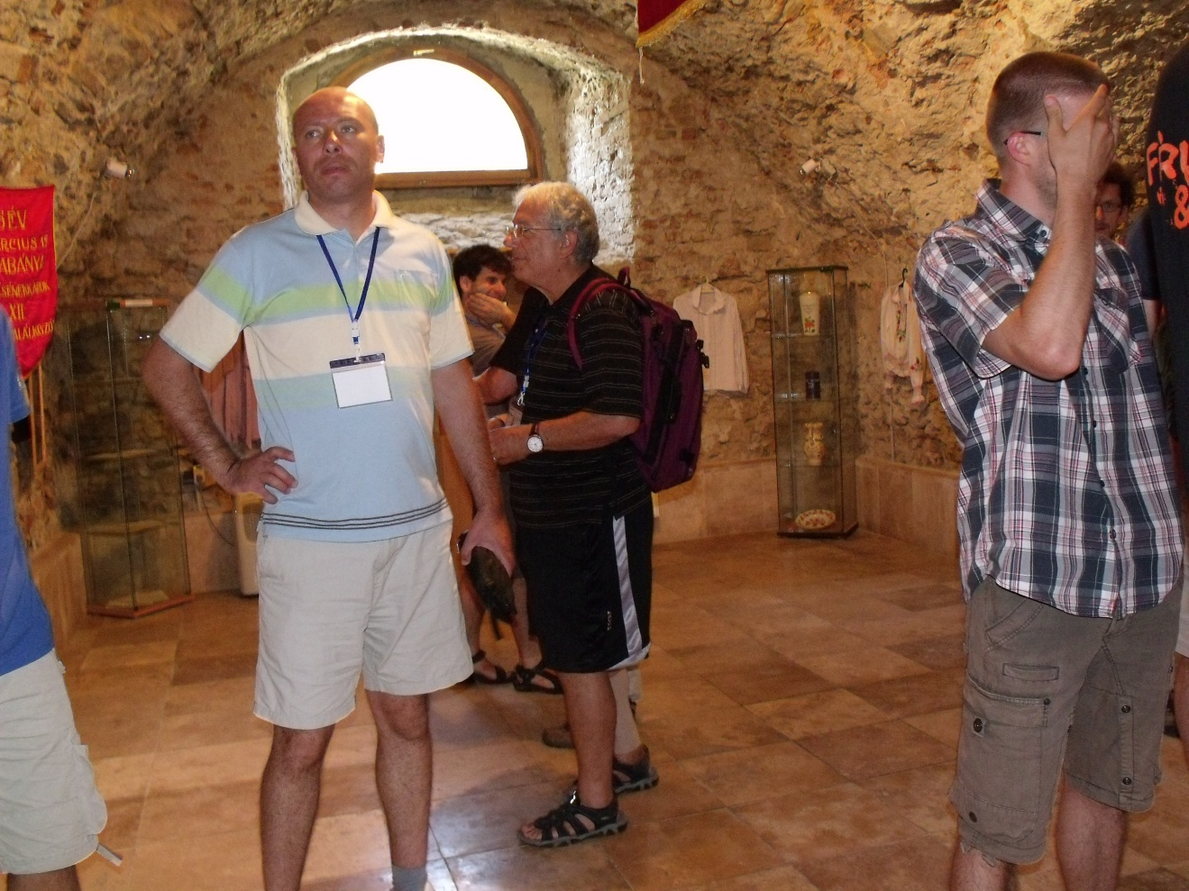
In the fort of Tata

Slide 14
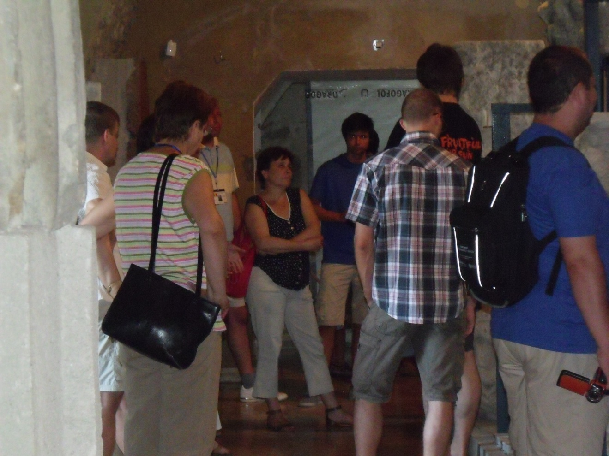
In the fort of Tata

Slide 15
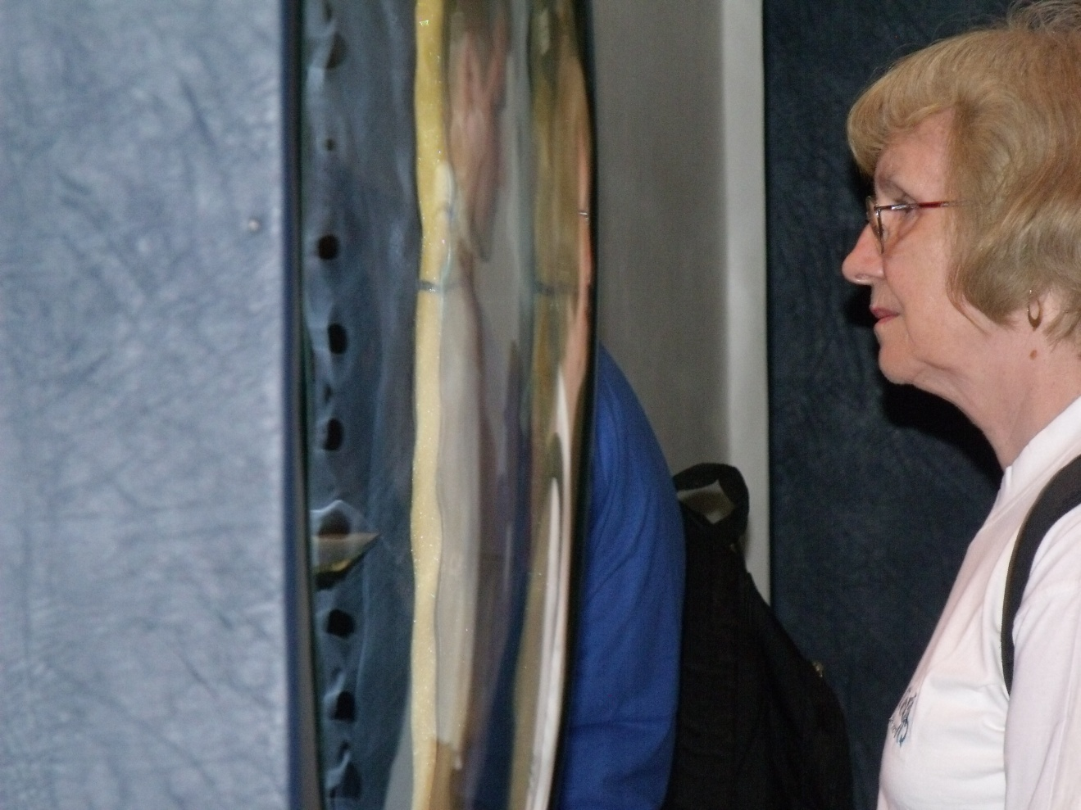
In the fort of Tata

Slide 16
Goulash party
11 July 2012, Wednesday

Slide 17
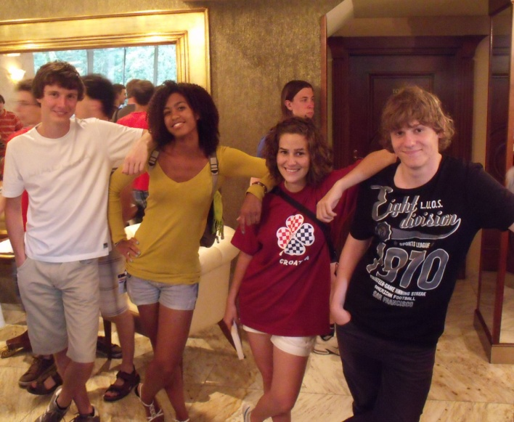
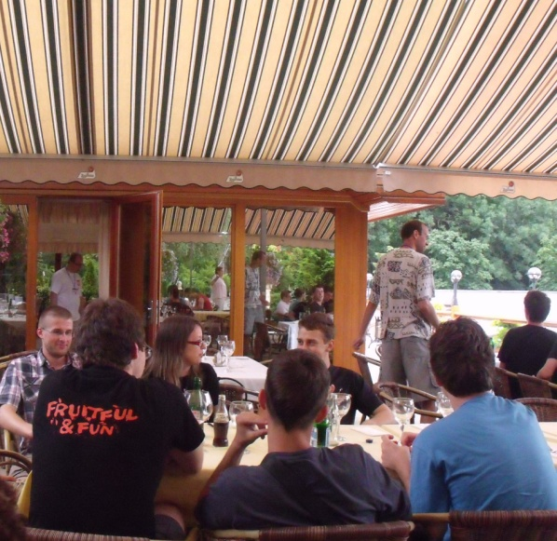
Moments of the Goulash party

Slide 18
Wine tasting
11 July 2012, Wednesday

Slide 19
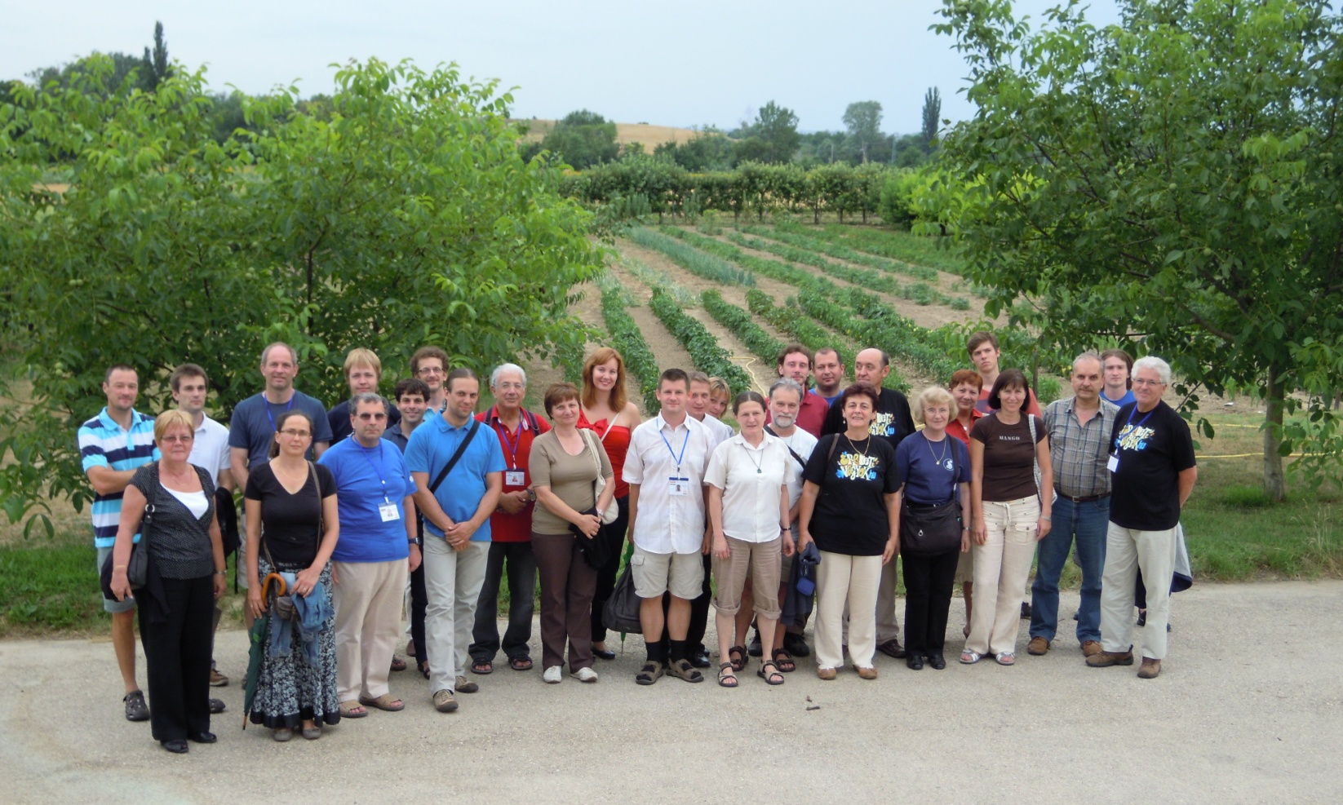
Moments of the Wine tasting

Slide 20
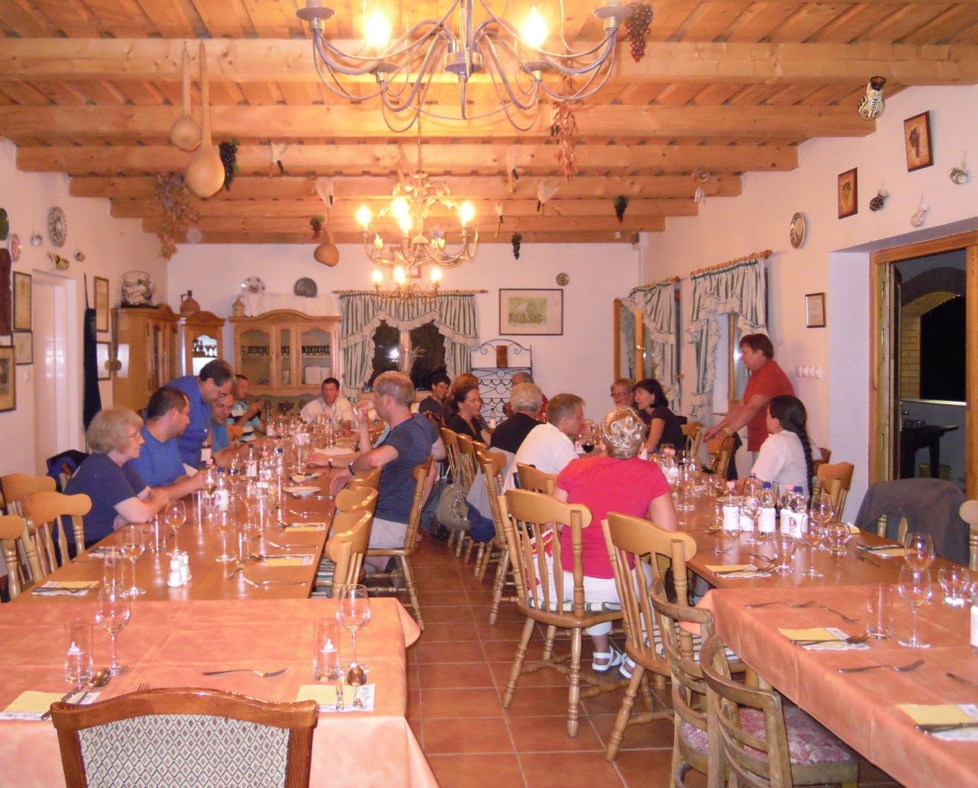
Wine tasting

Slide 21
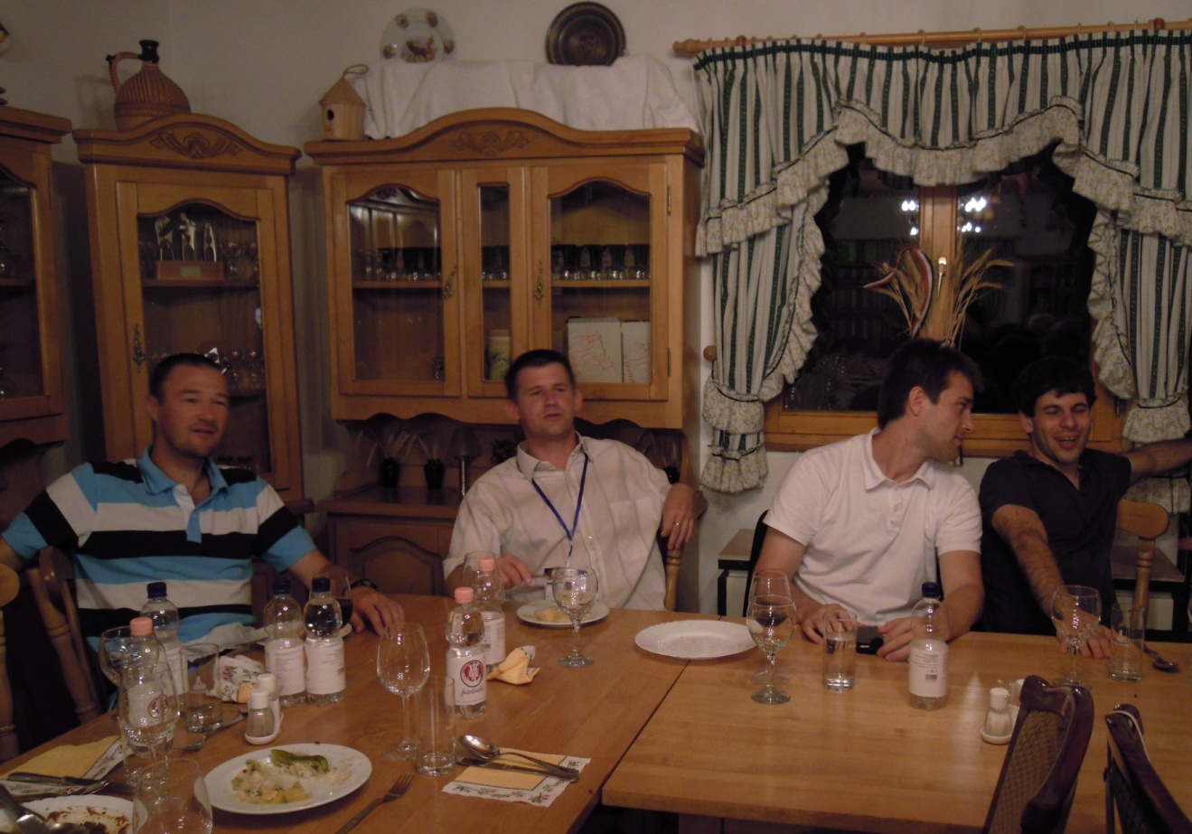
Wine tasting

Slide 22
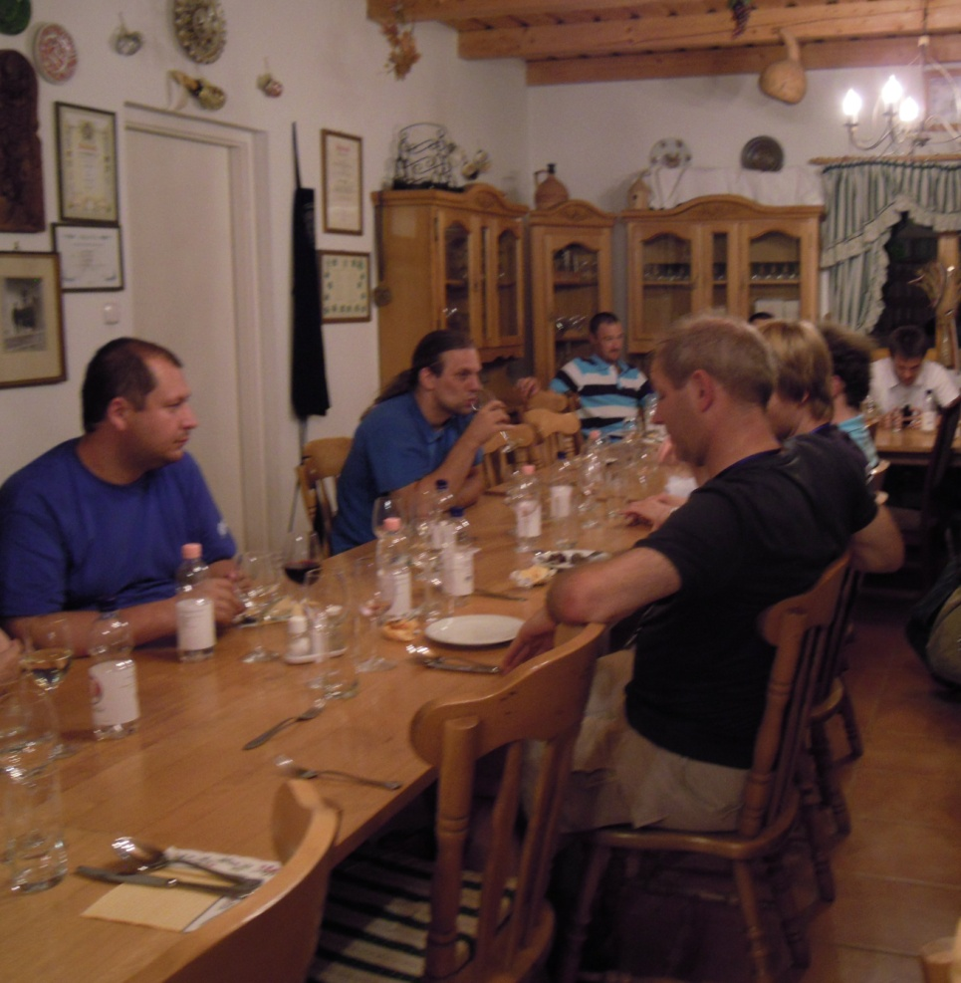
Wine tasting

