Slide 1
The Day of the Arrival
7 July 2012, Saturday

Slide 2
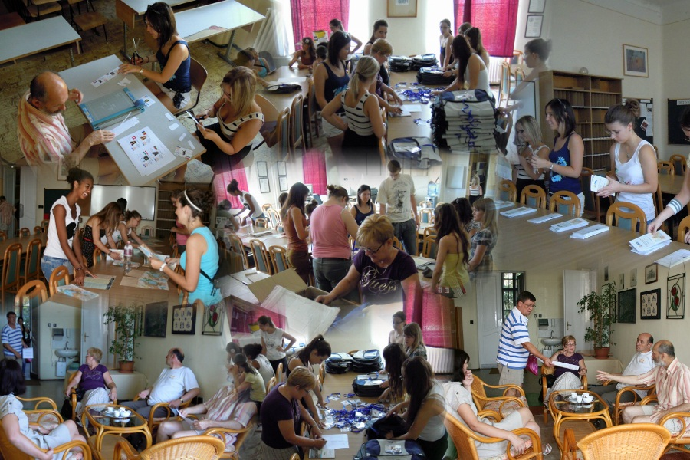
Preparations

Slide 3
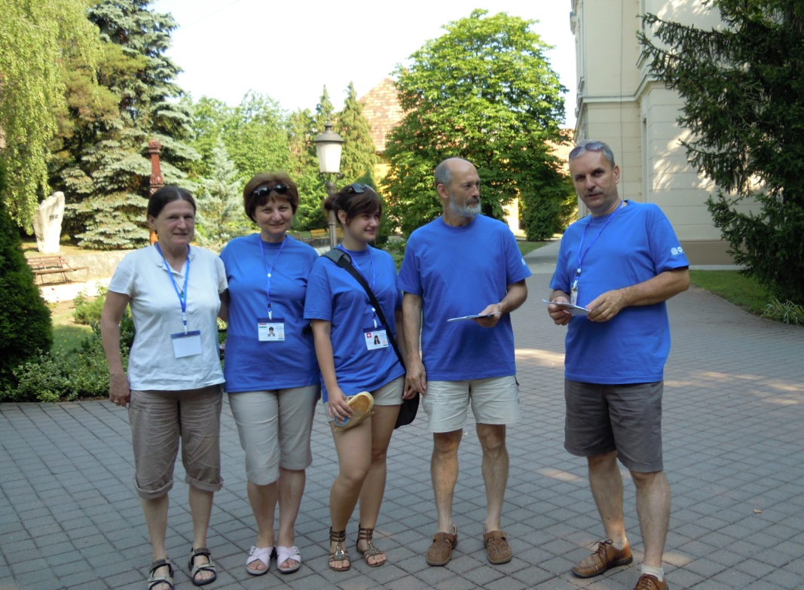
Waiting for the Teams

Slide 4
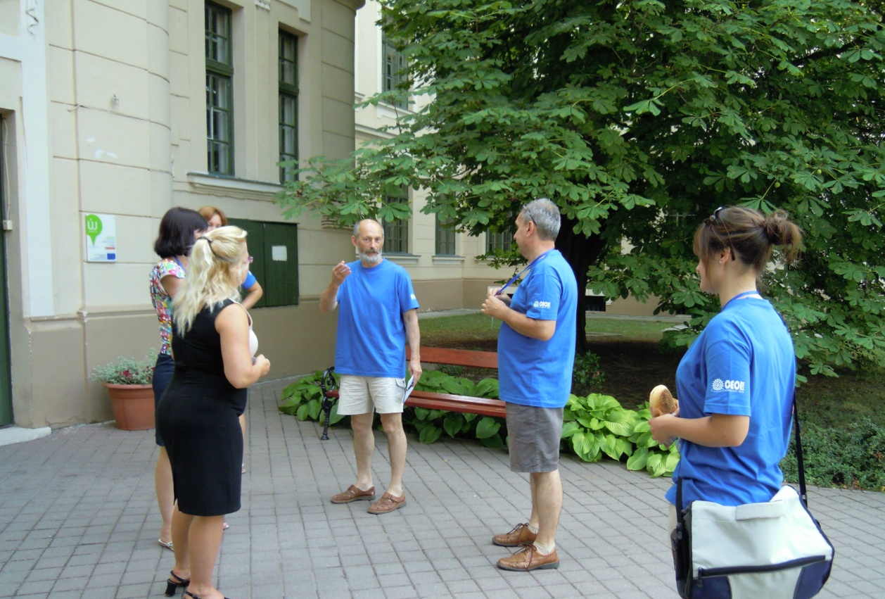
Waiting for the Teams

Slide 5
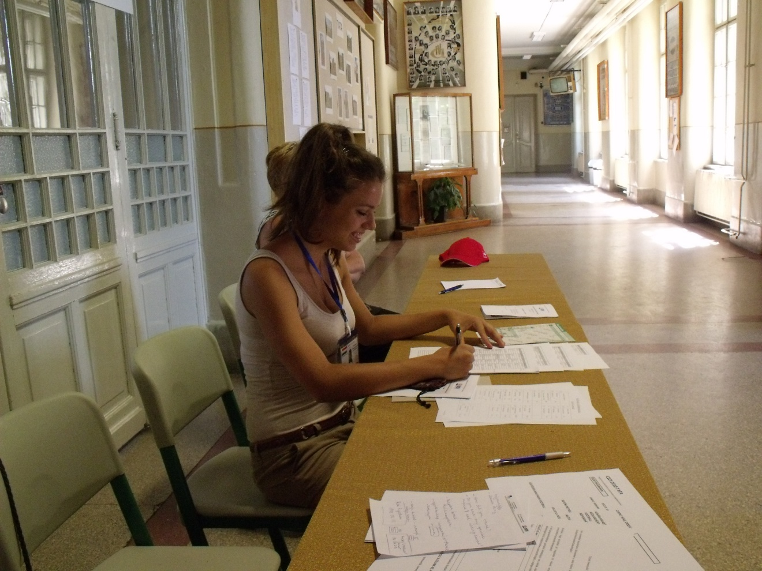
Registration

Slide 6
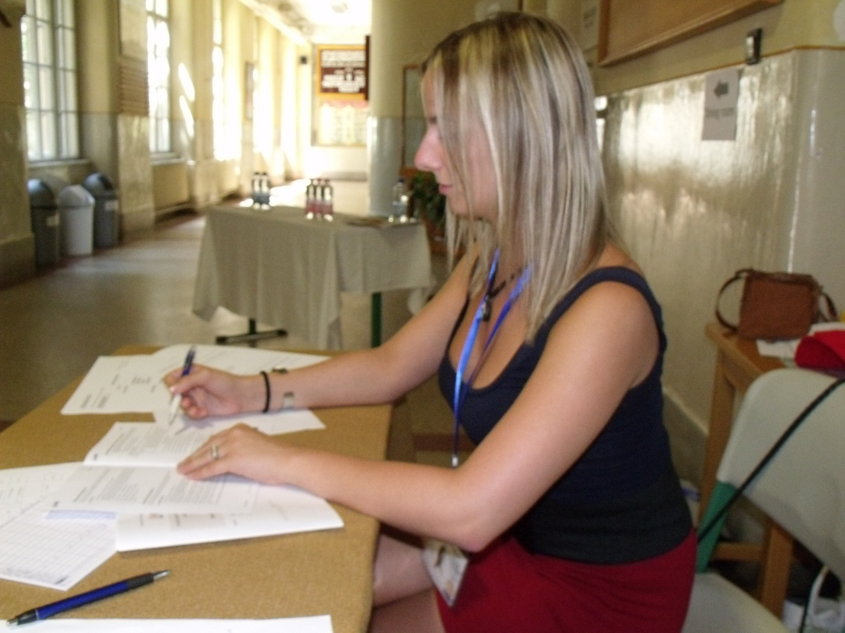
Registration

Slide 7
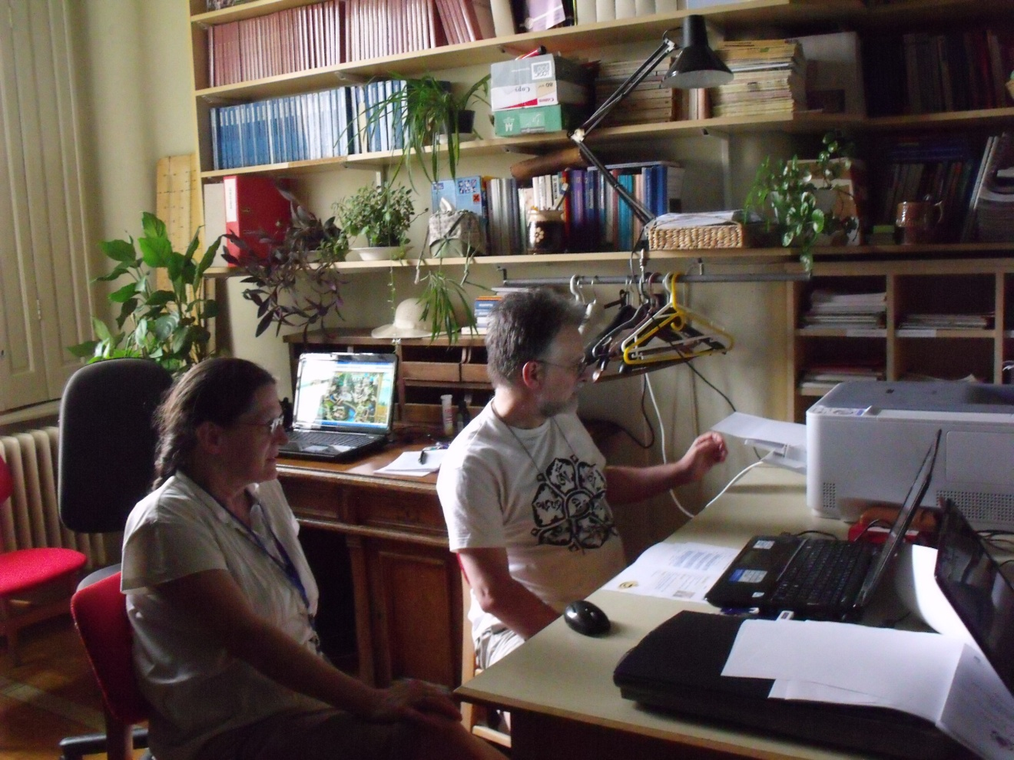
News room

Slide 8
Competing teams

Slide 9
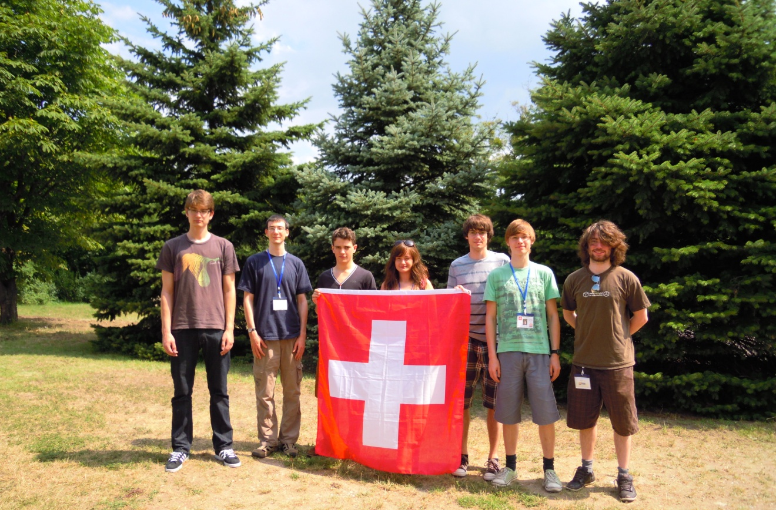
Swiss Team

Slide 10
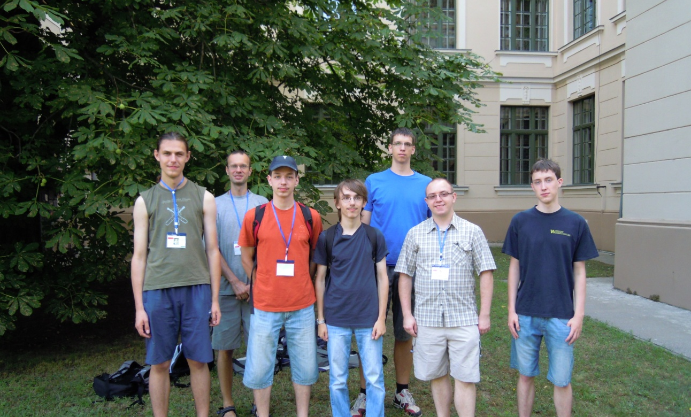
Polish Team

Slide 11
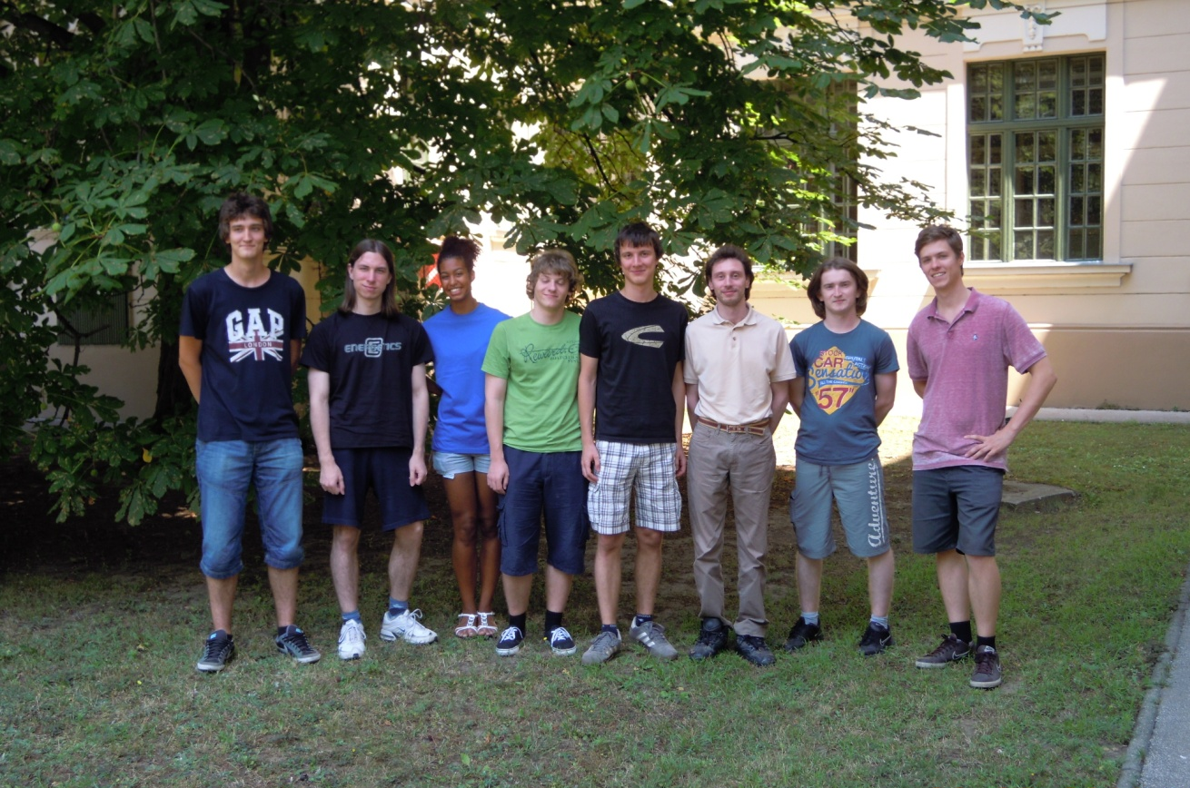
Croatian Team

Slide 12
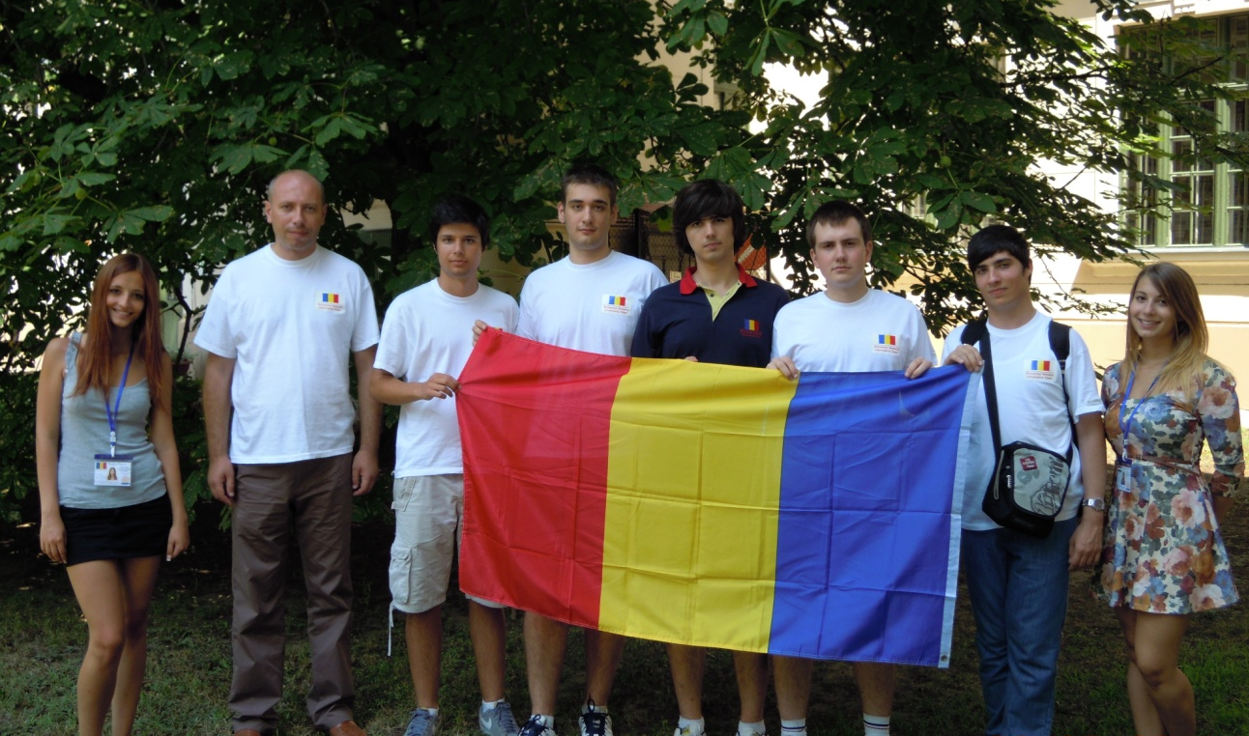
Romanian Team

Slide 13
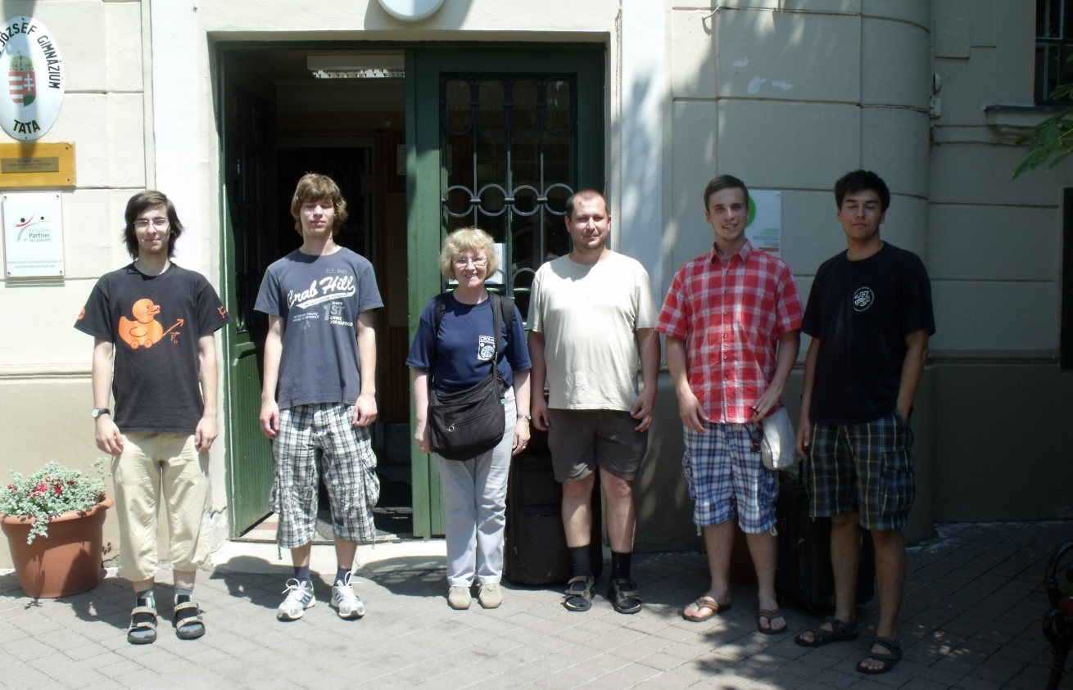
Slovakian Team

Slide 14
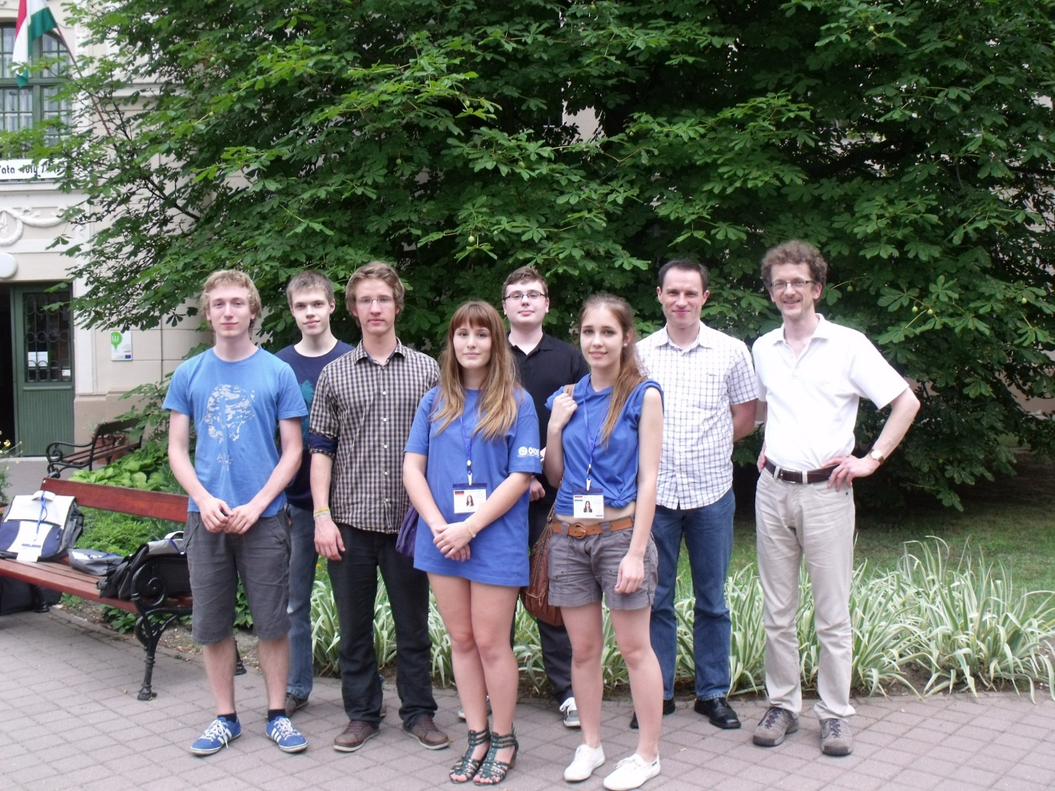
German Team

Slide 15
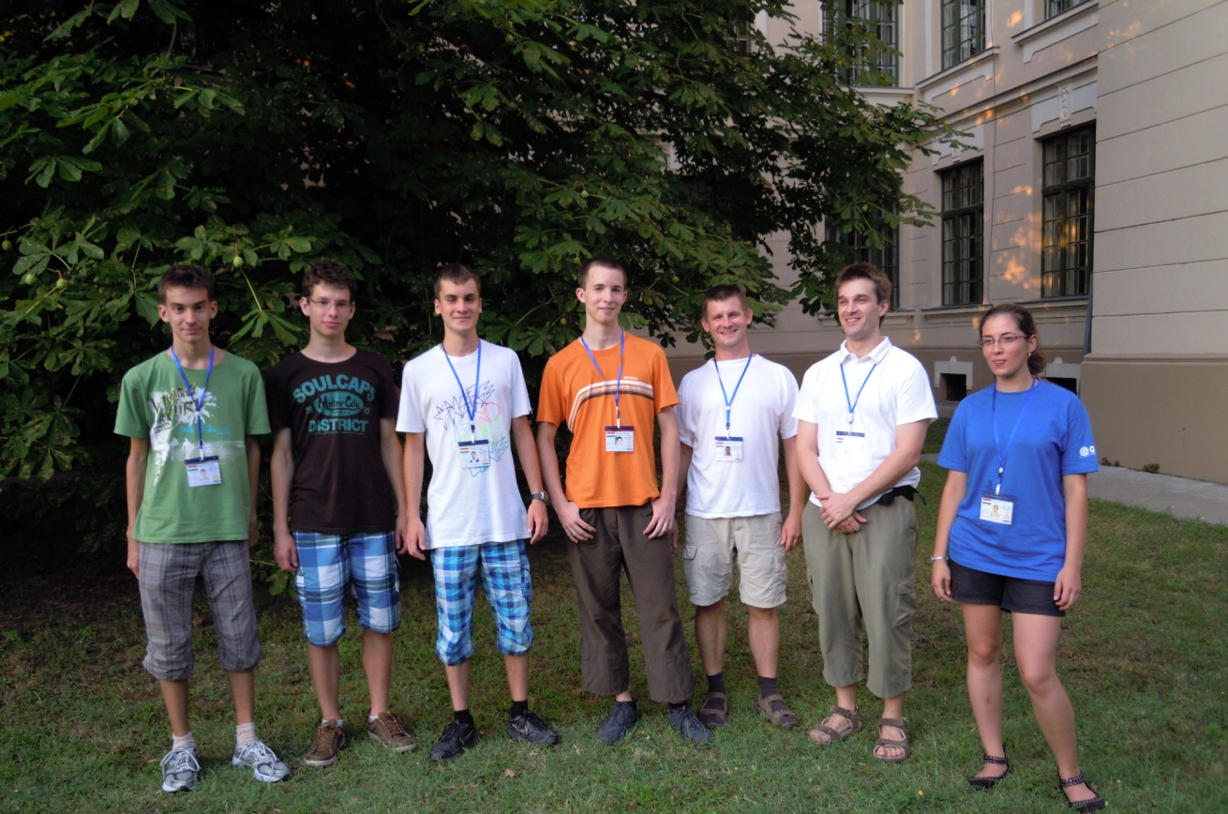
Hungarian Team 1

Slide 16
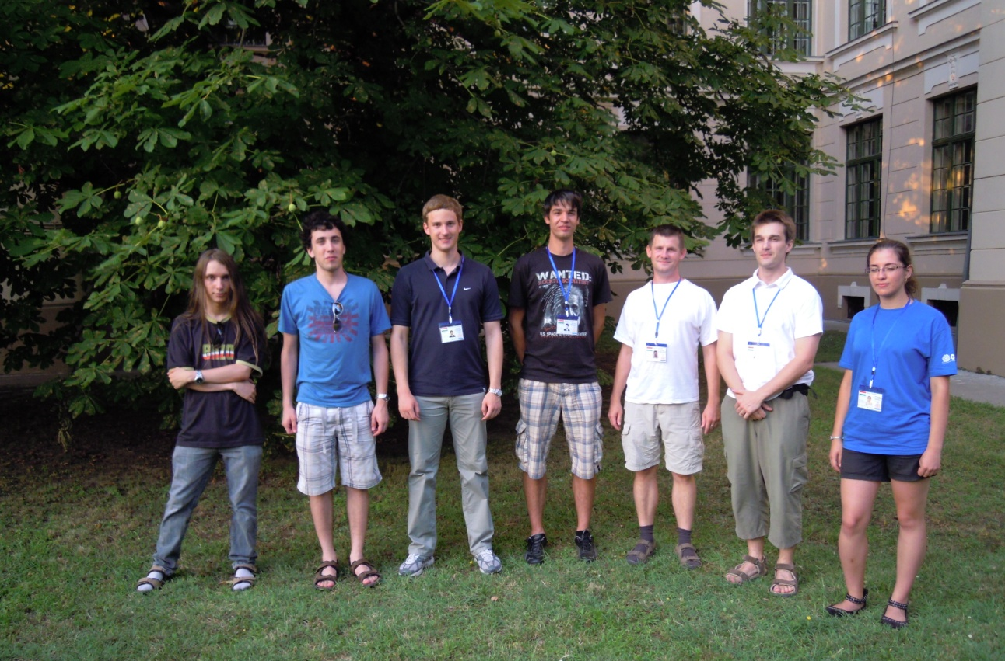
Hungarian Team 2

Slide 17
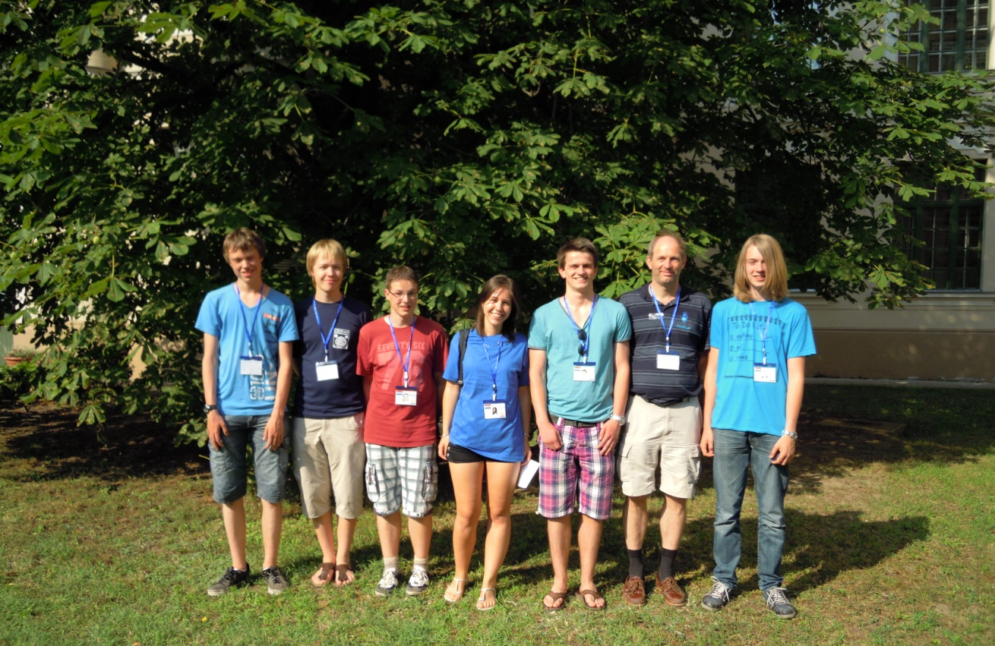
Dutch Team

Slide 18
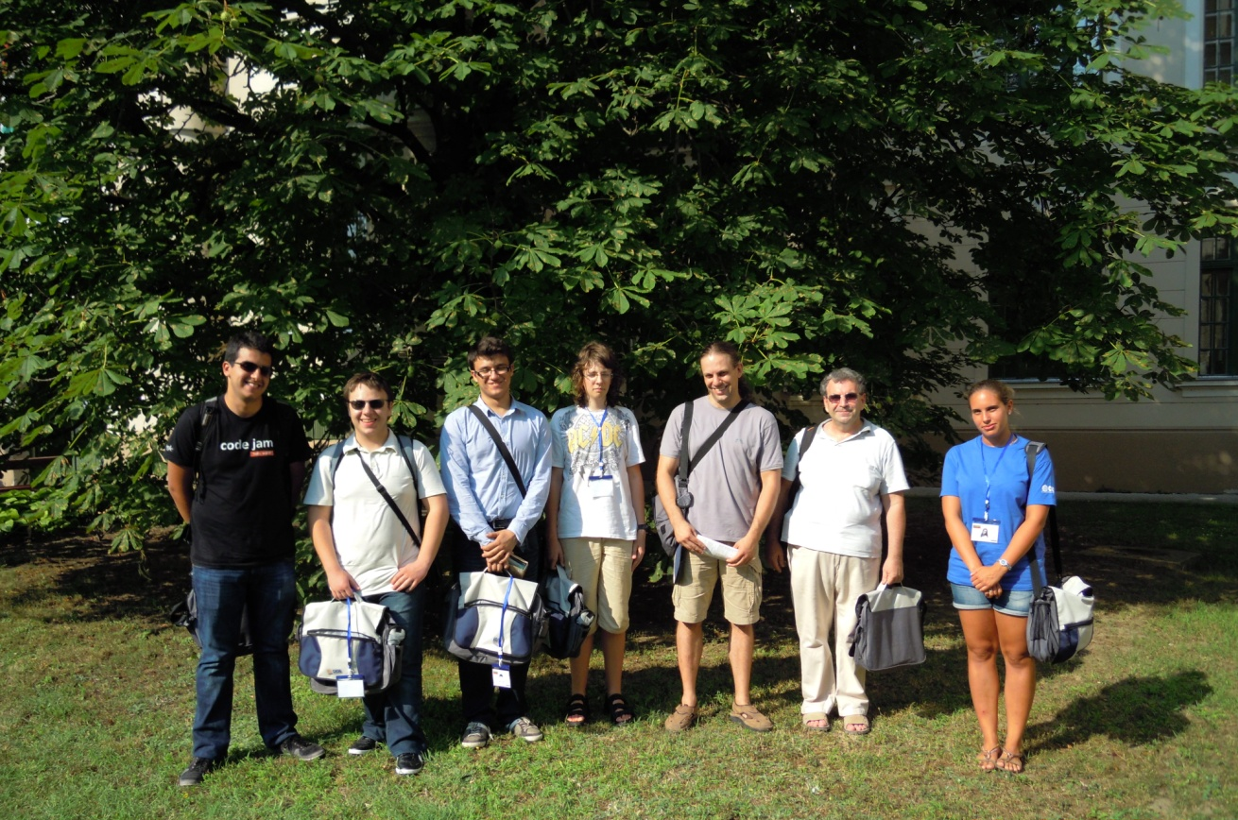
Bulgarian Team

Slide 19
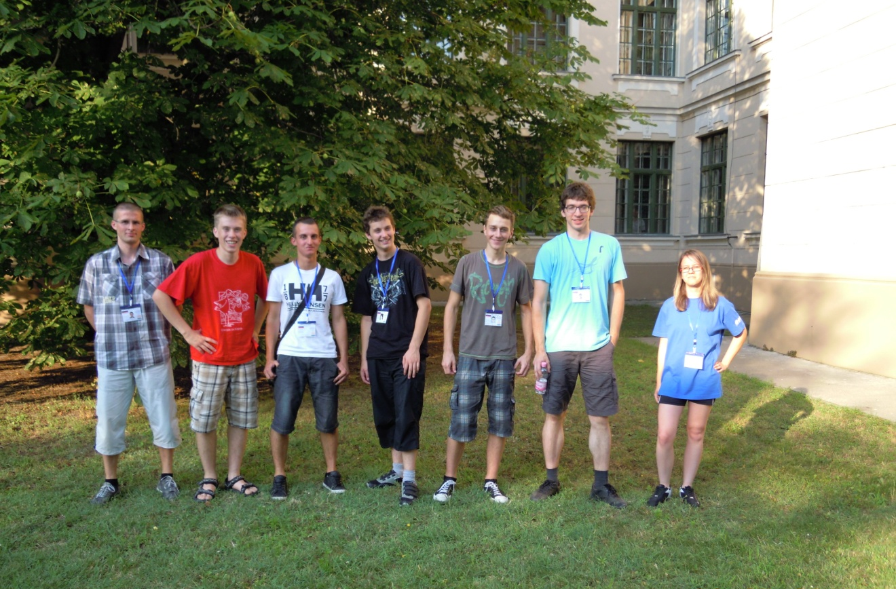
Slovenian Team

Slide 20
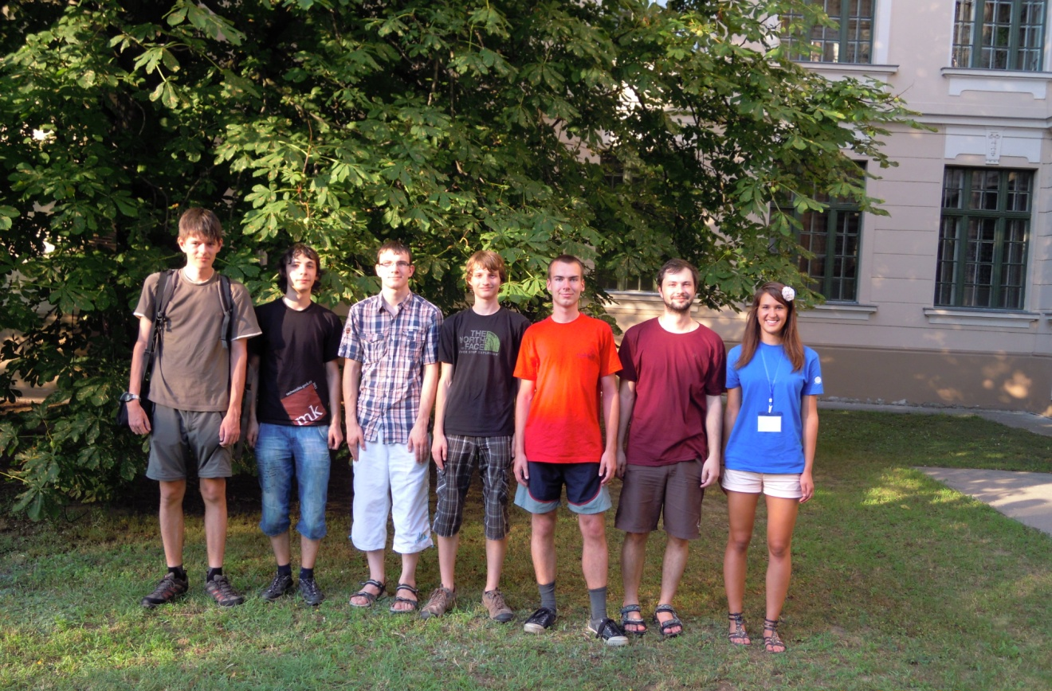
Czech Team

Slide 21
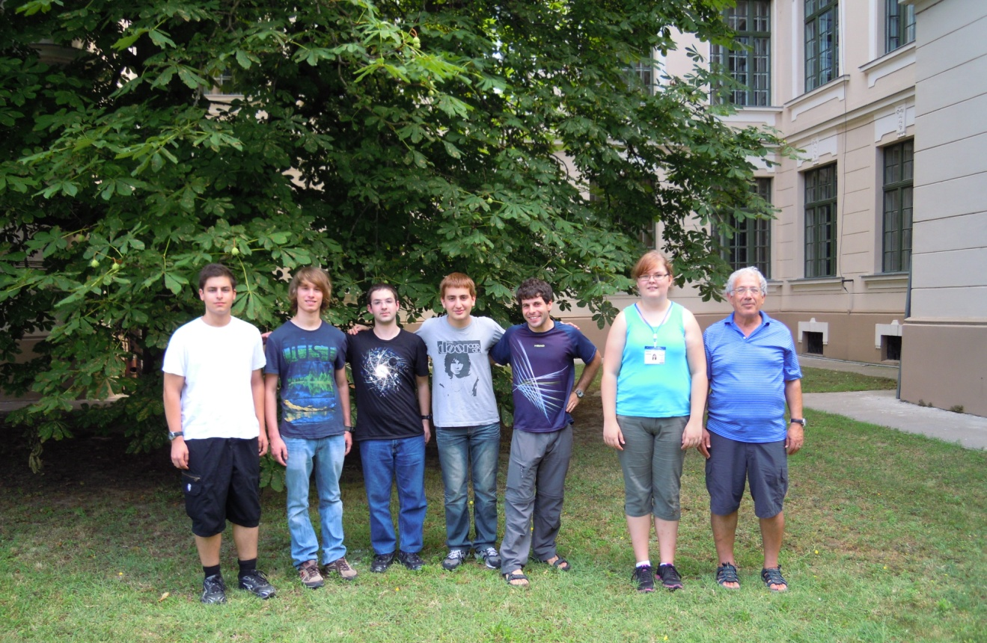
Israeli Team

Slide 22
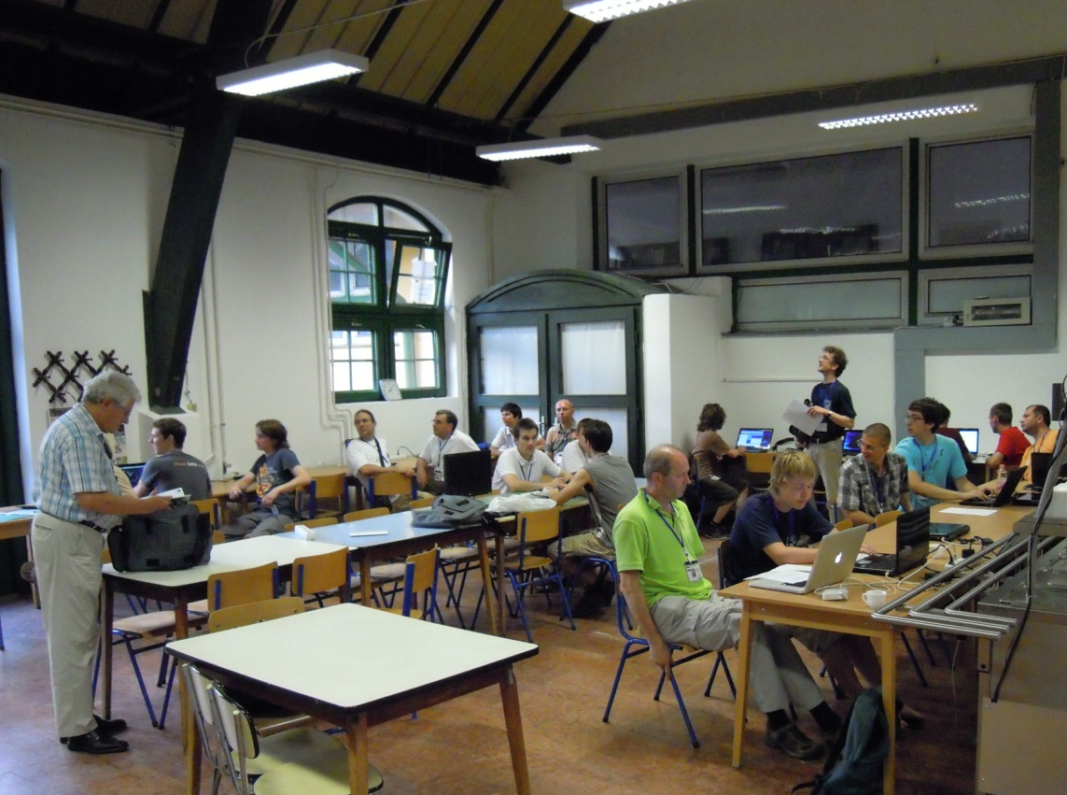
General Assembly Meeting

