Slide 1
Competition: 1st Session
9 July 2012, Monday

Slide 2
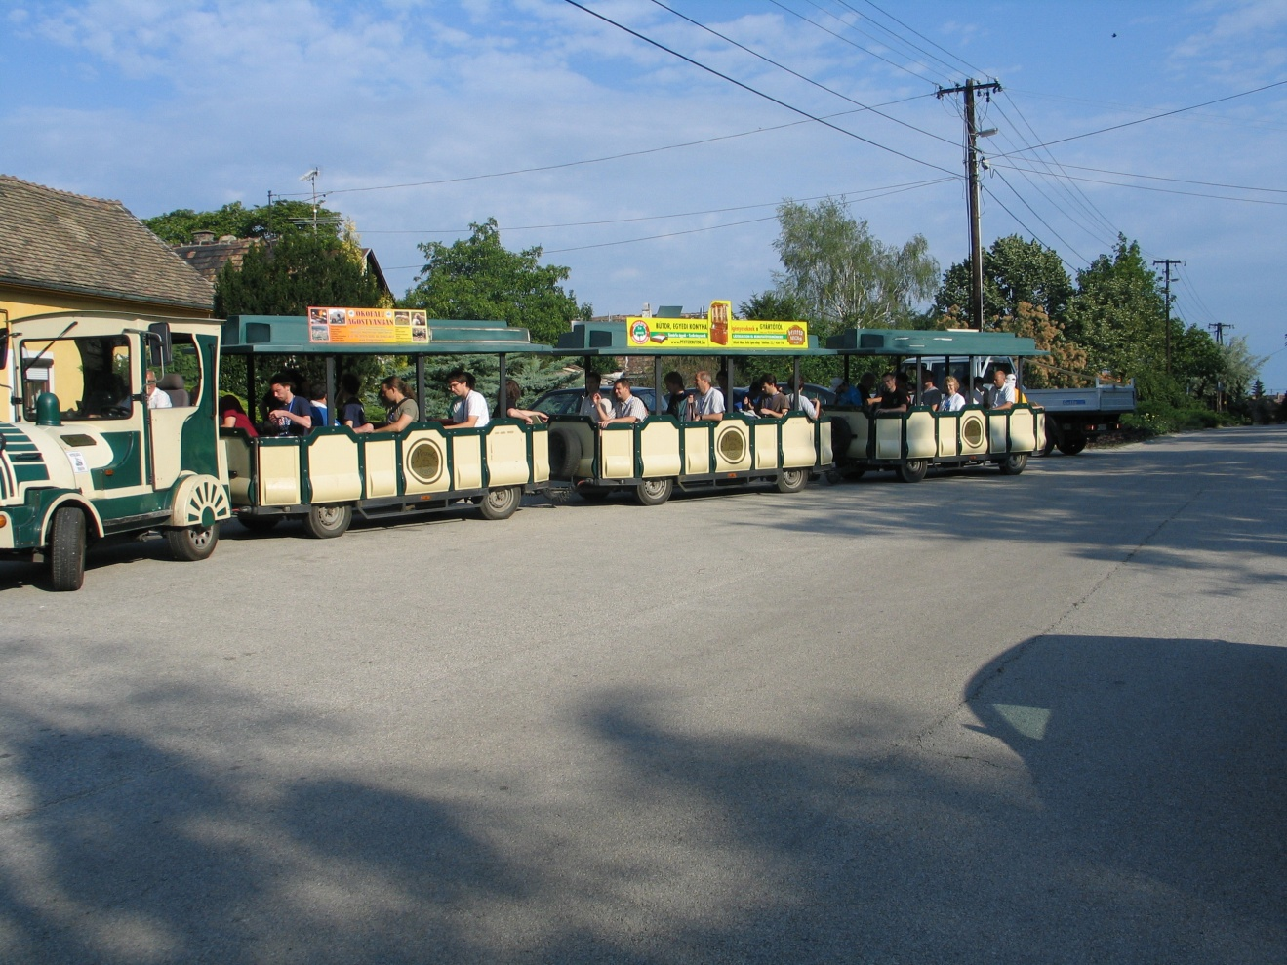
Arrival

Slide 3
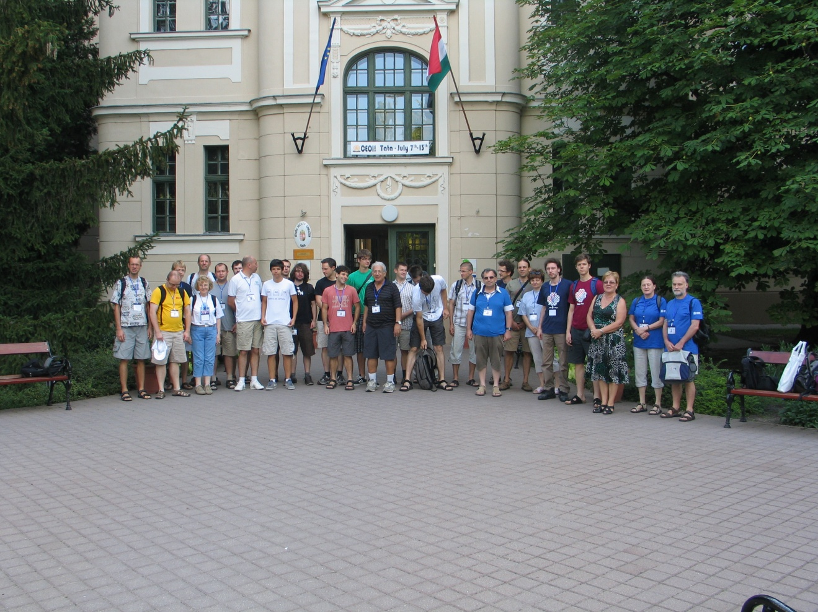
The teachers

Slide 4
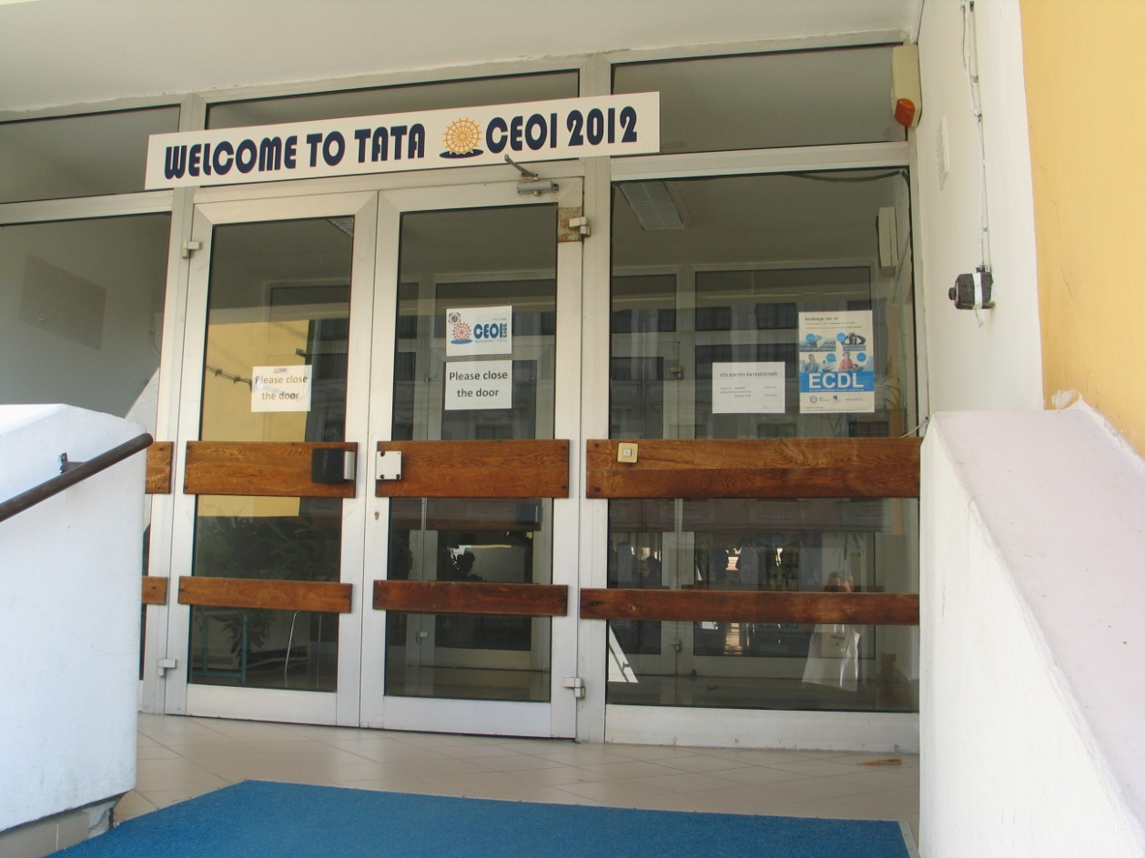
Before the competition

Slide 5
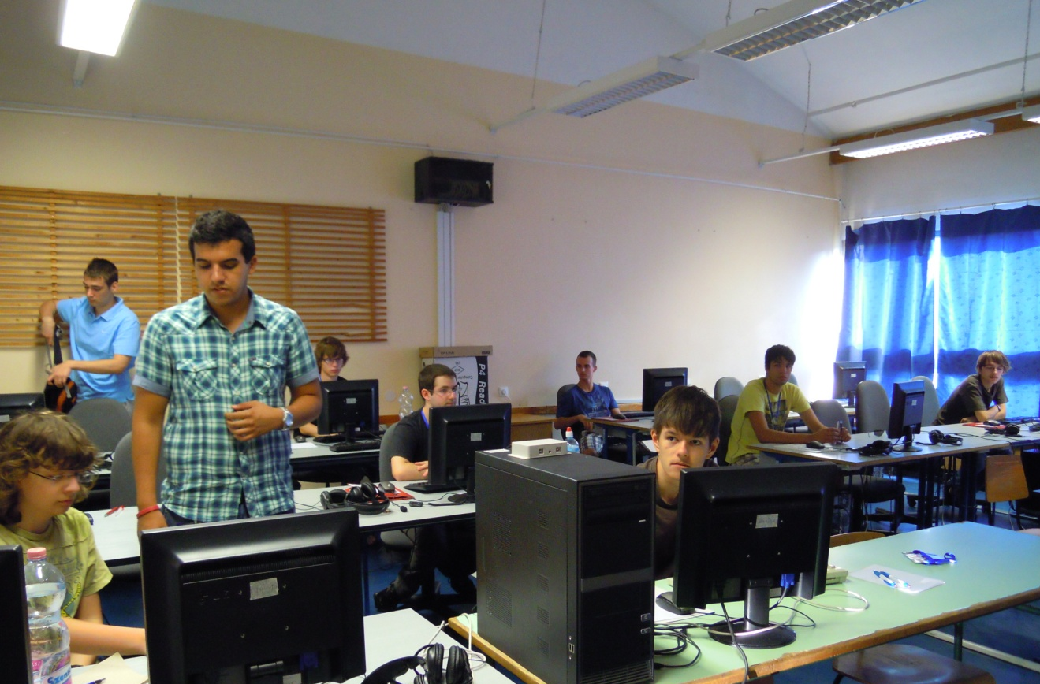
Preparation for the first competiton day

Slide 6
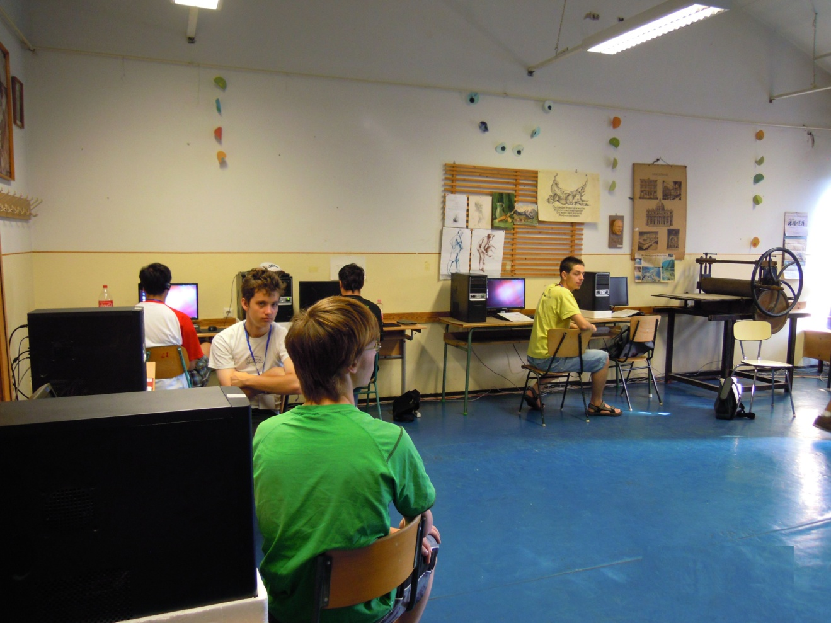
Preparation for the first competiton day

Slide 7
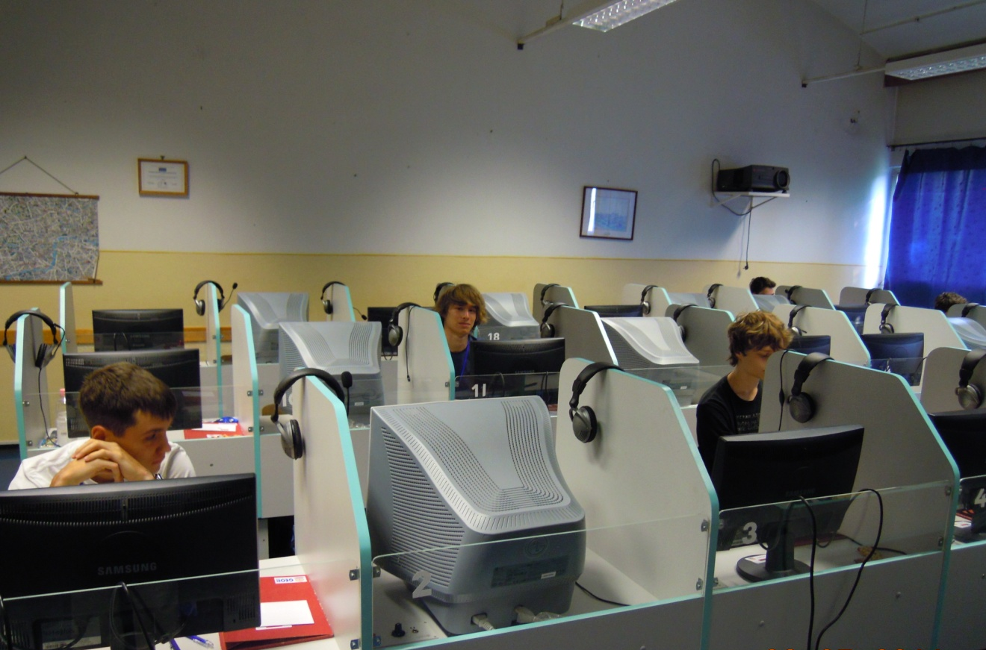
Preparation for the first competiton day

Slide 8
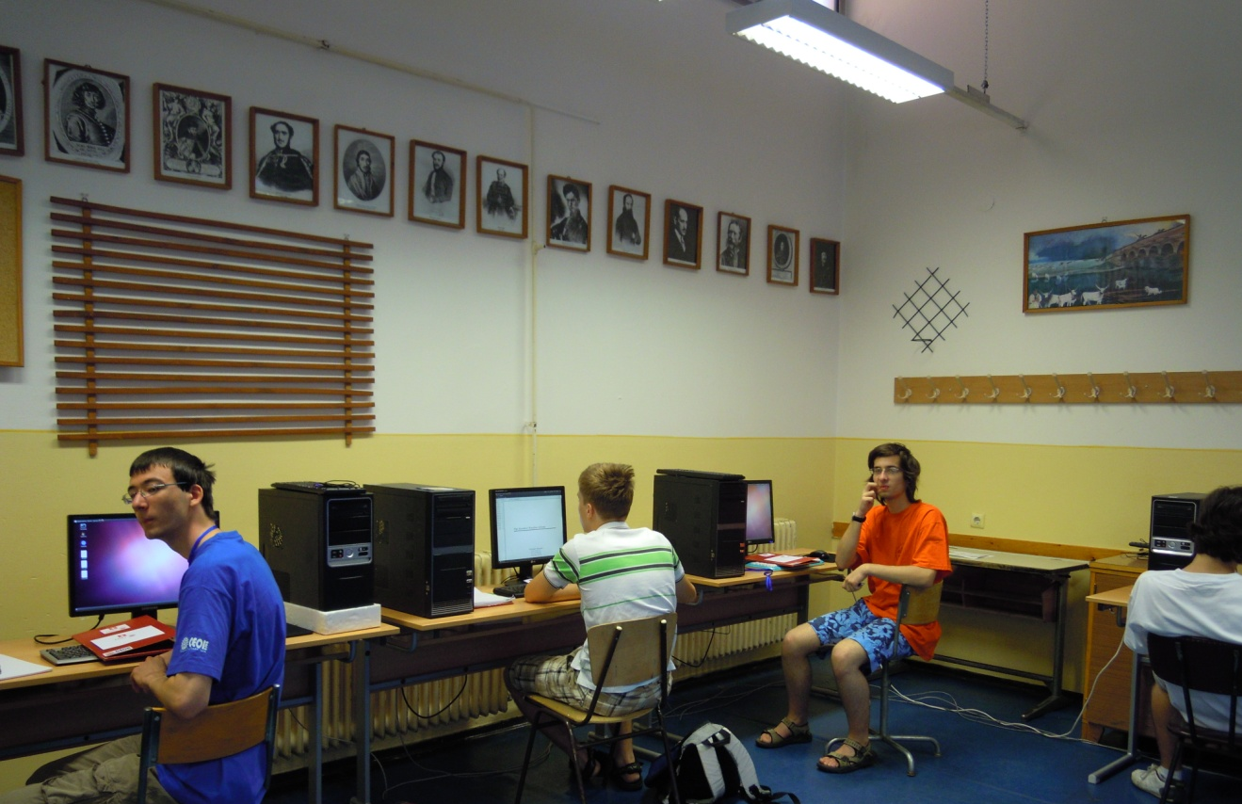
Preparation for the first competiton day

Slide 9
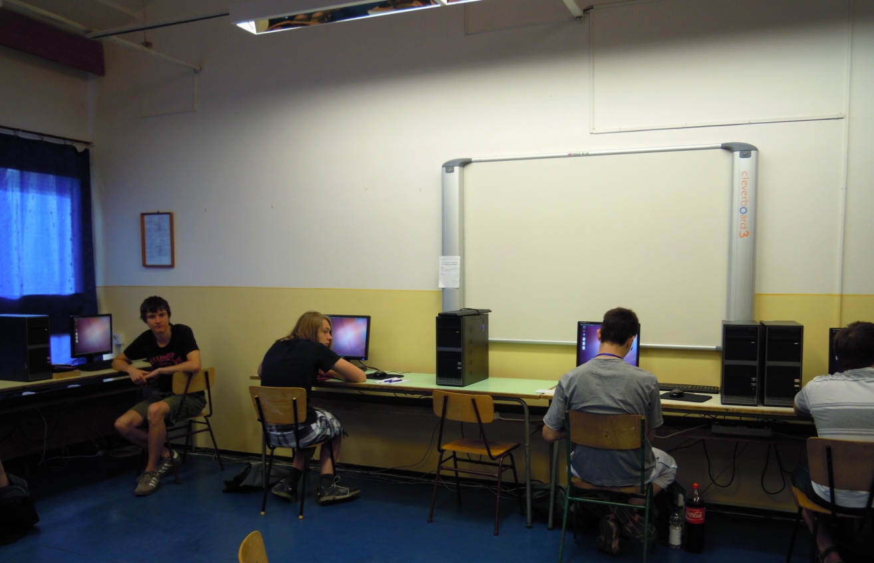
Preparation for the first competiton day

Slide 10
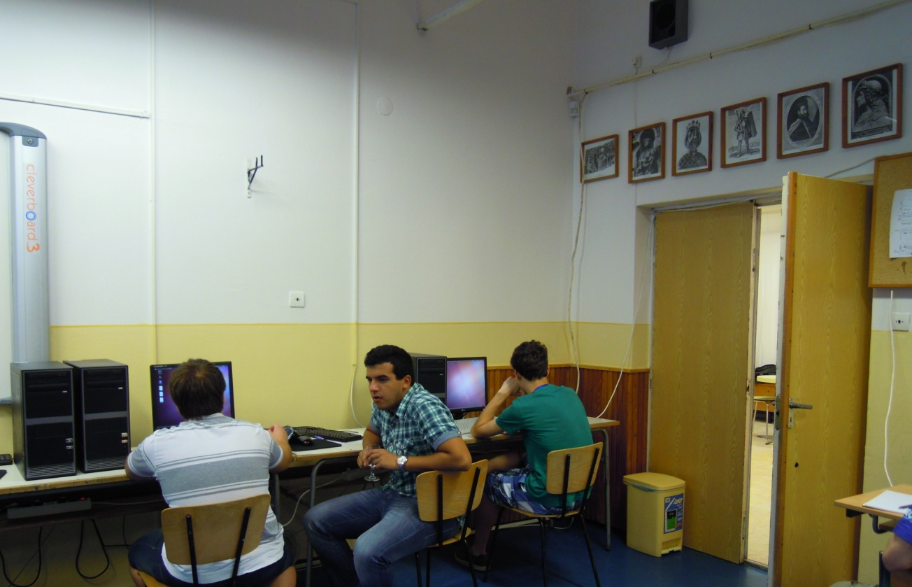
Preparation for the first competiton day

Slide 11
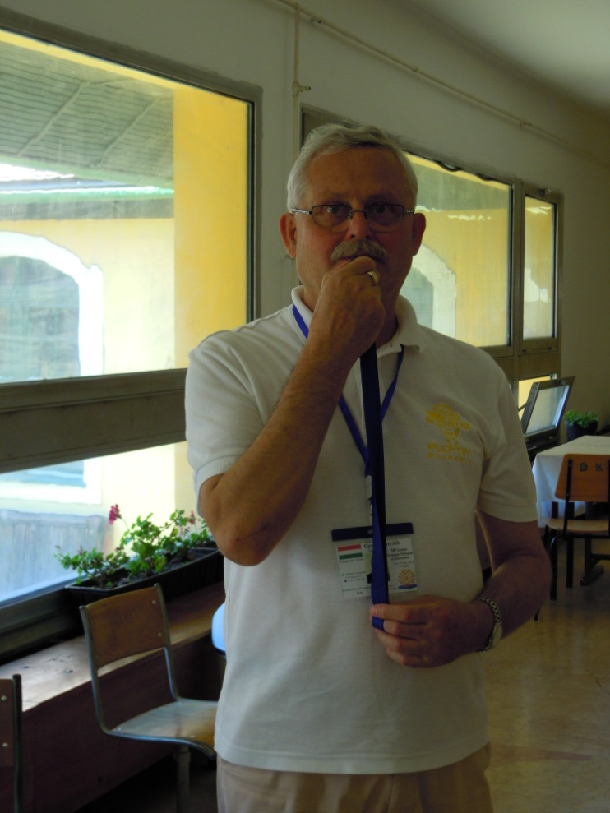
Start

Slide 12
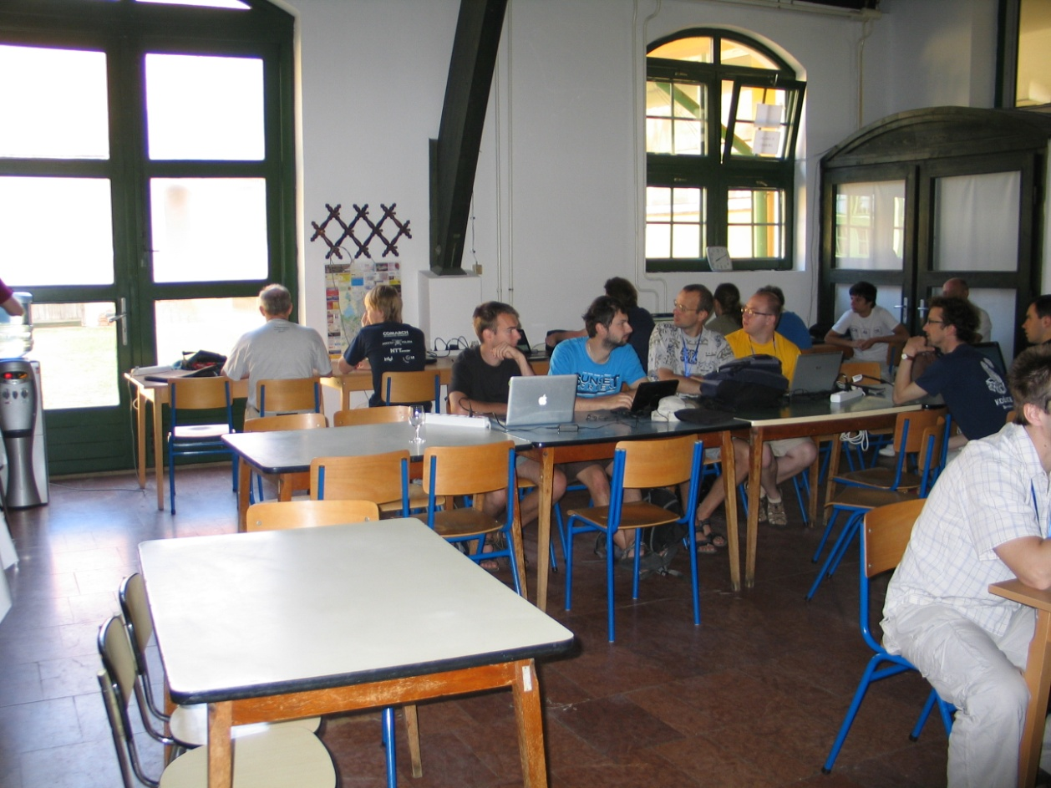
Waiting for the first results

Slide 13
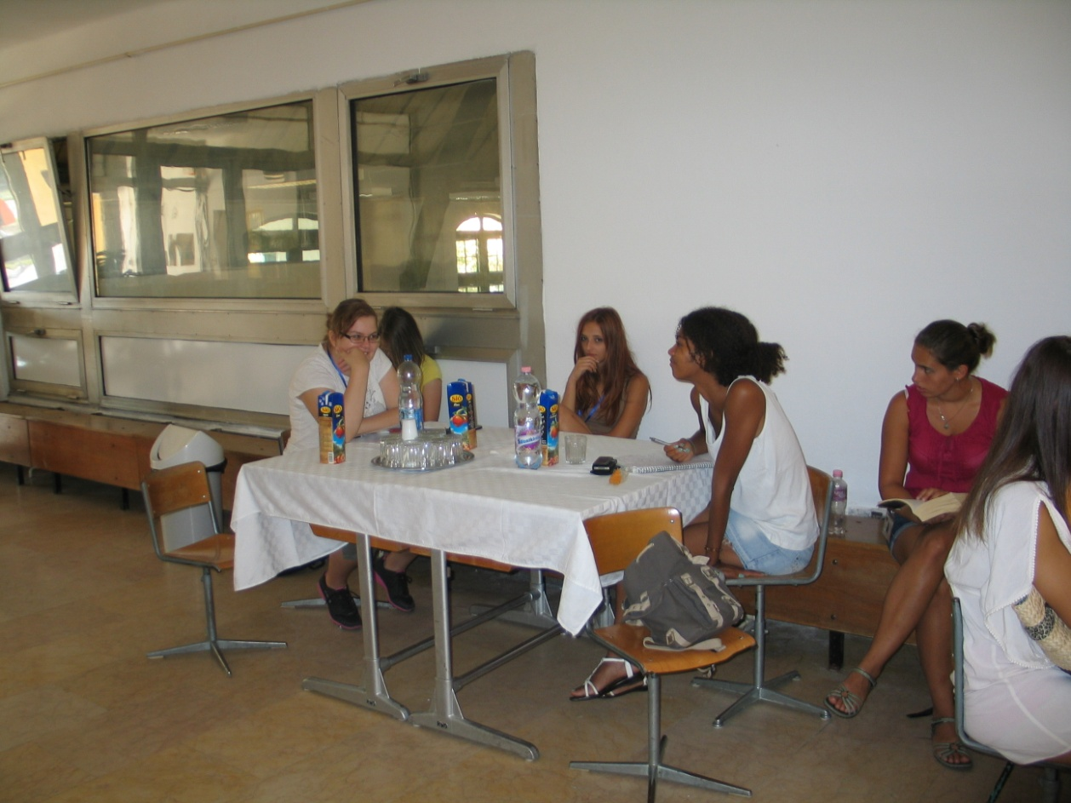
Guides

Slide 14
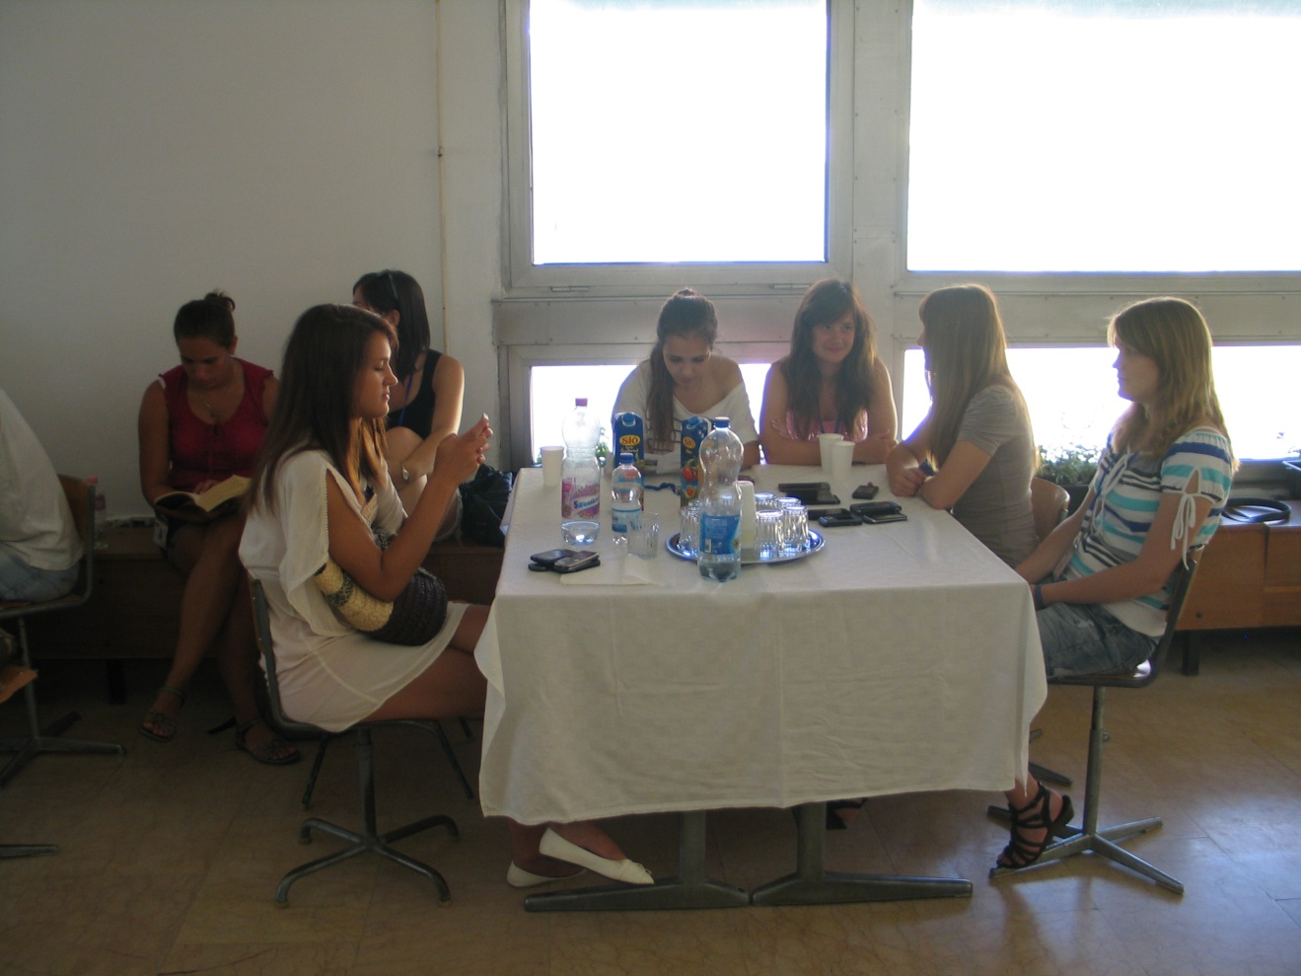
Waiting…

Slide 15
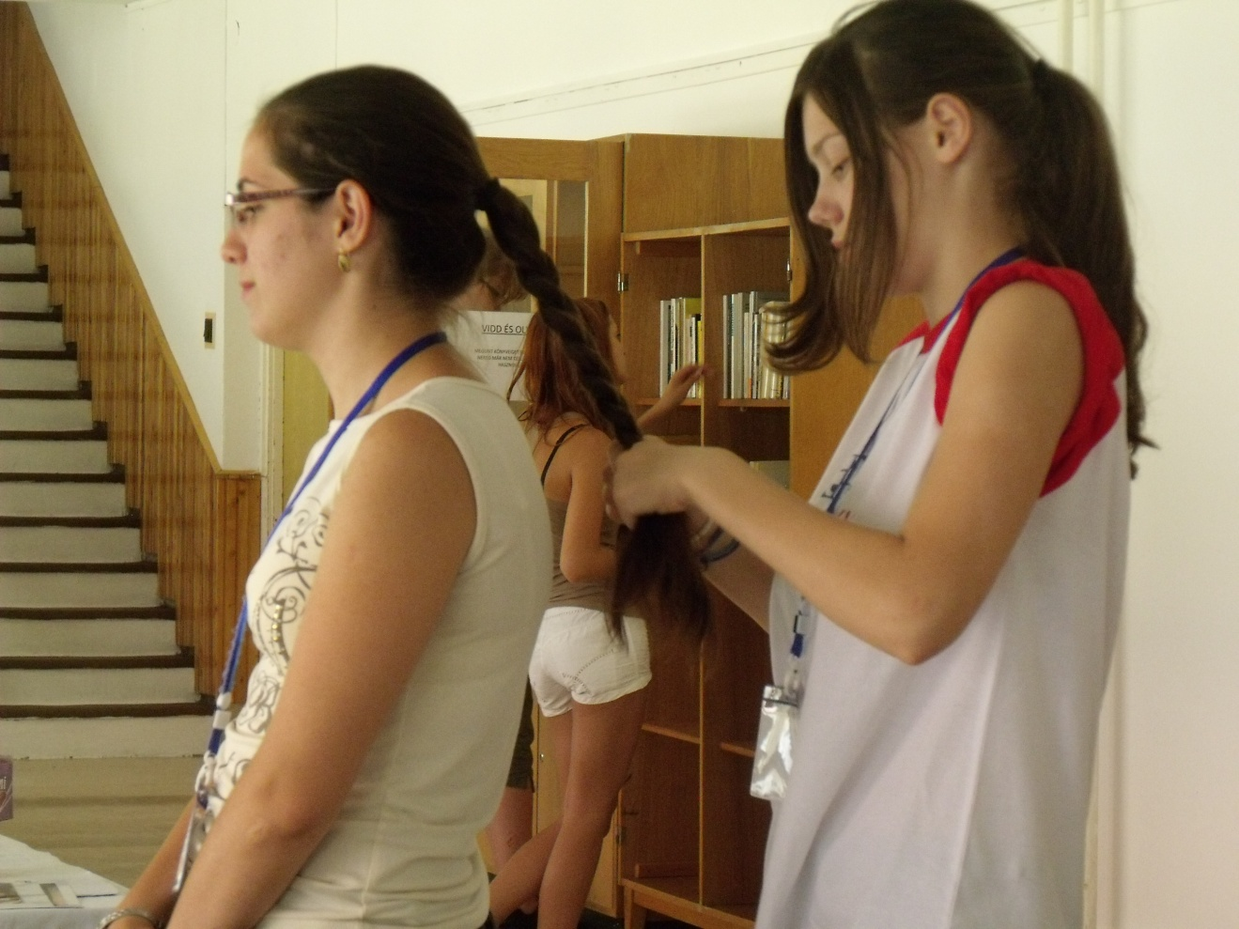
Waiting…

Slide 16
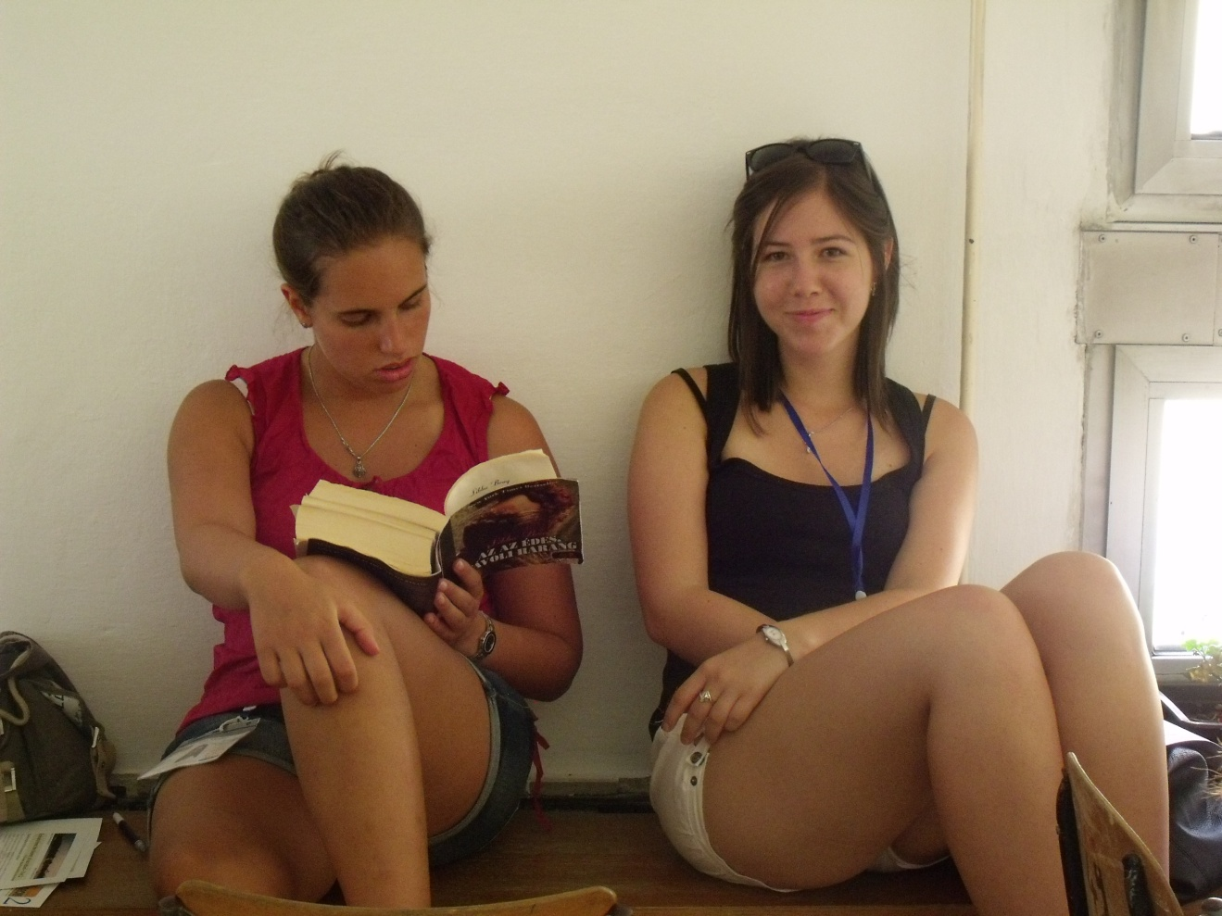
Waiting…

Slide 17
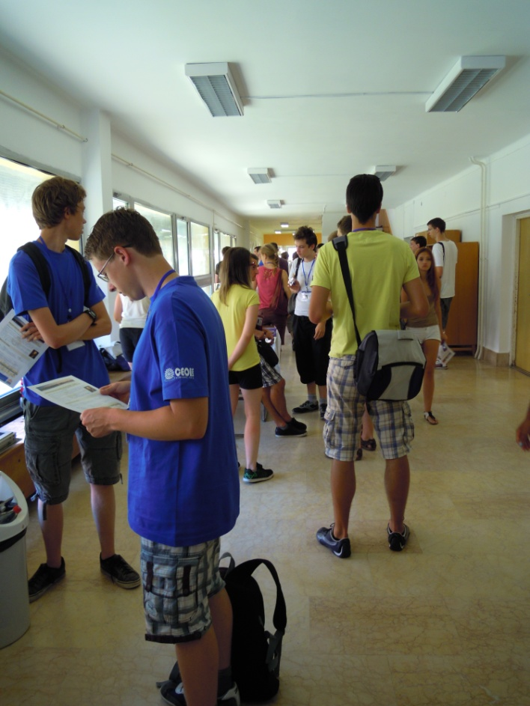
After the competition

Slide 18
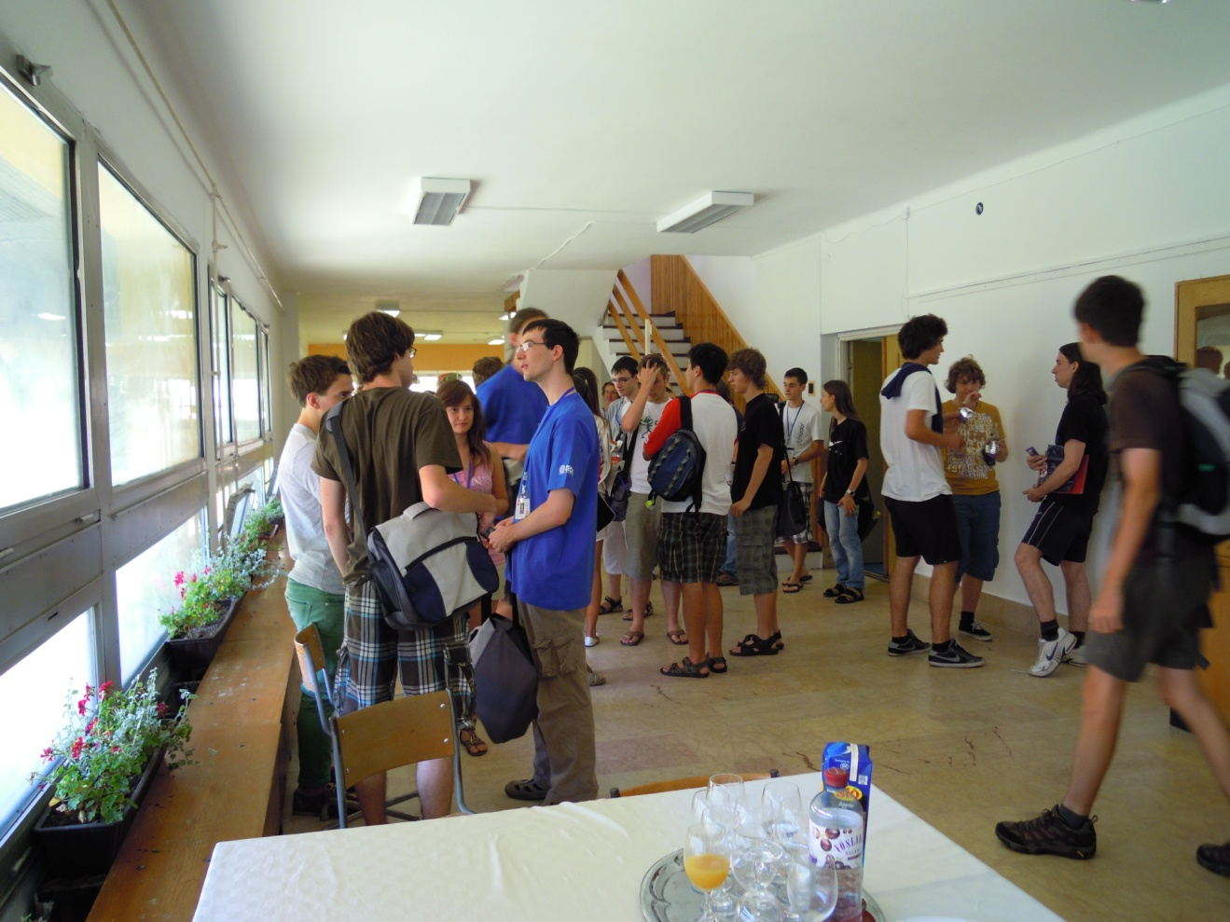
Exchanging information

Slide 19
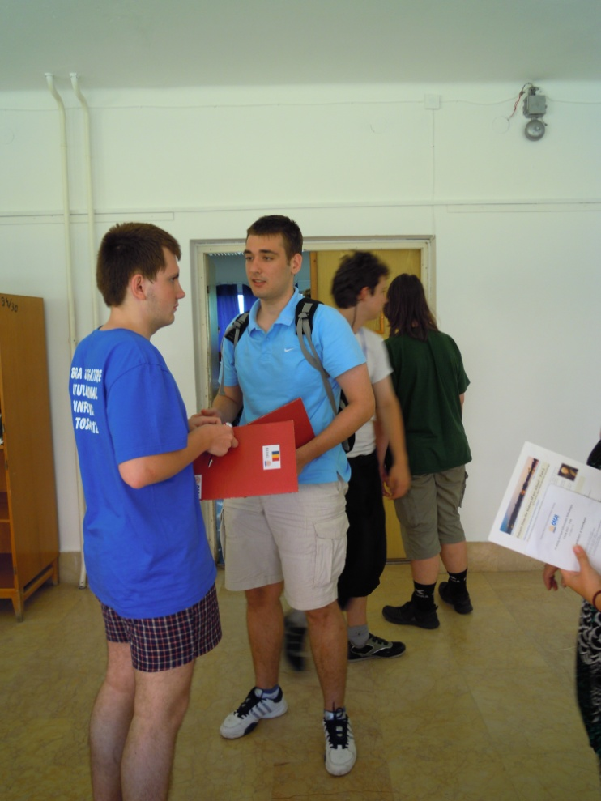
Exchanging information

Slide 20
Statistics

Slide 21
Statistics

Slide 22
Statistics

Slide 23
Geological Museum of
Eötvös University and
Calvary Hill
9 July 2012, Monday

Slide 24
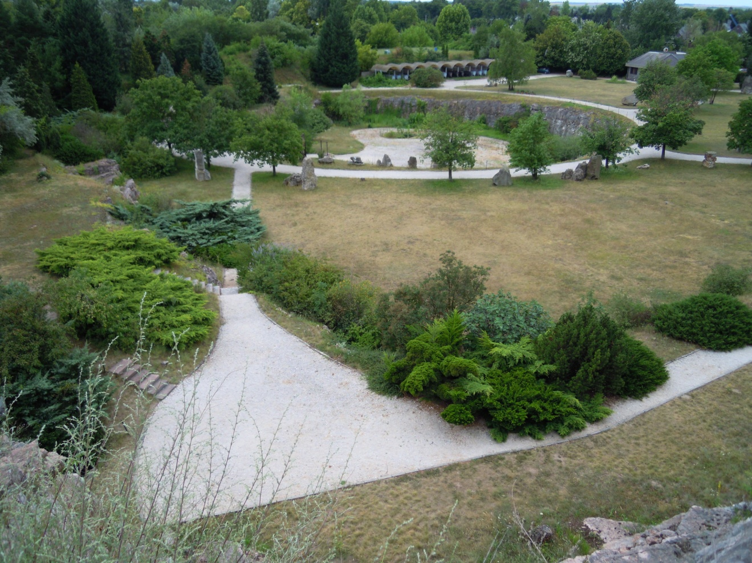
The park of the geological museum

Slide 25
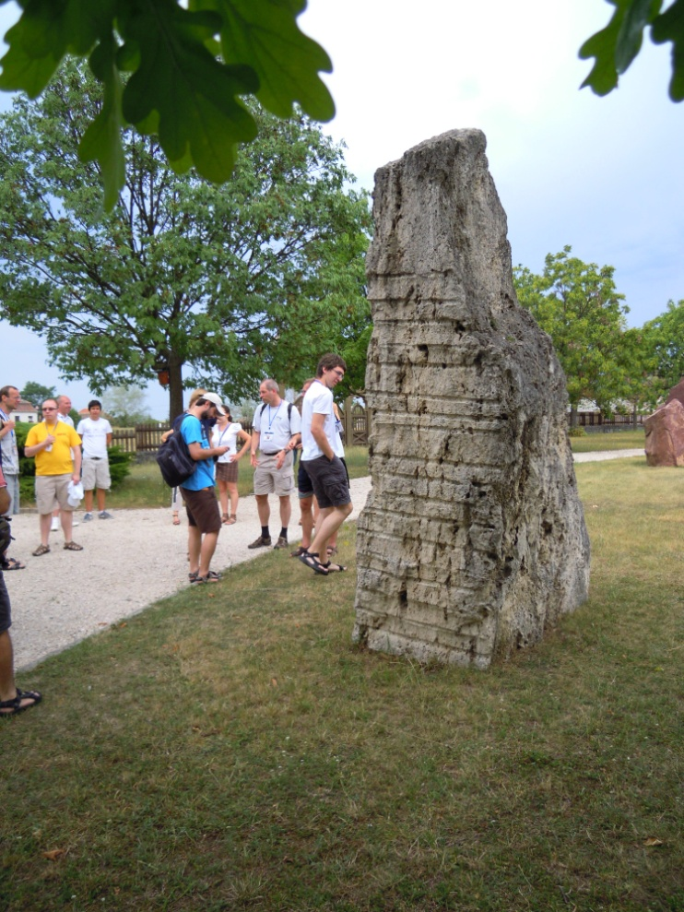
The park

Slide 26
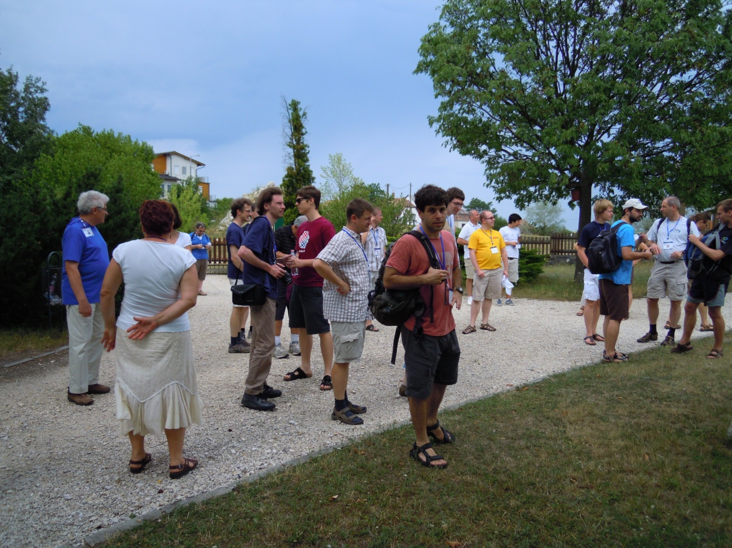
Looking around

Slide 27
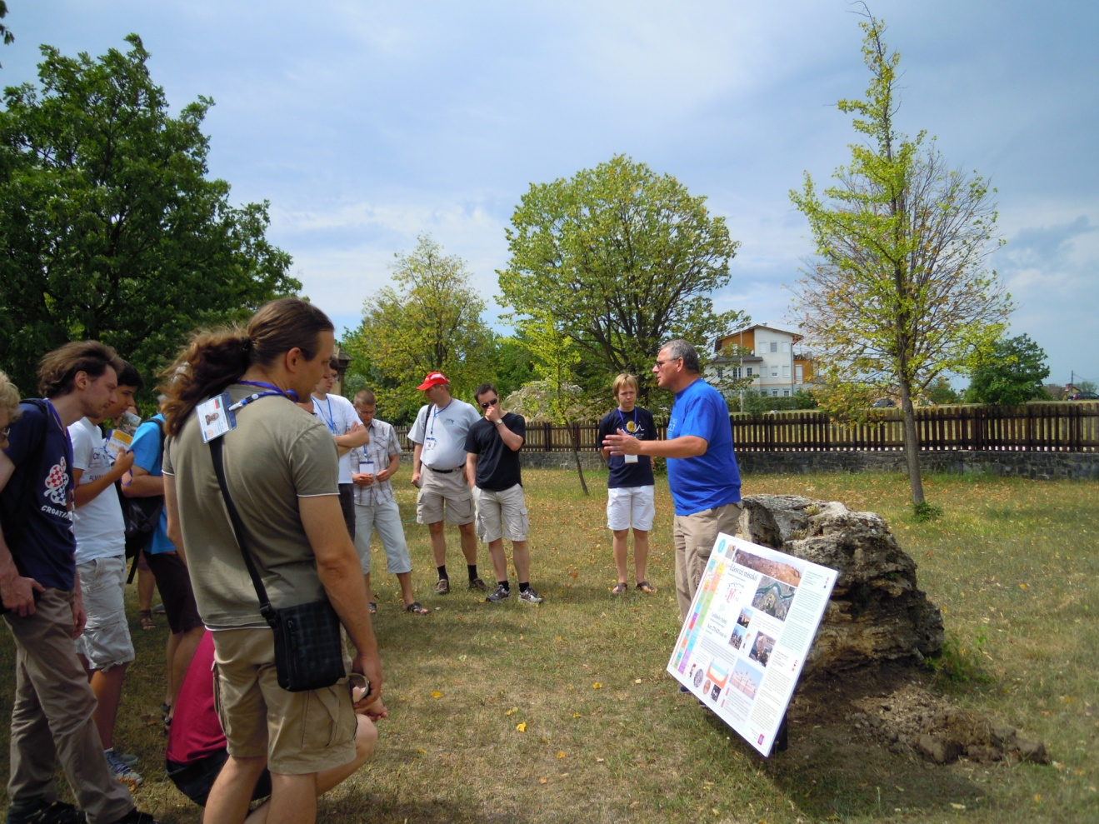
Looking around

Slide 28
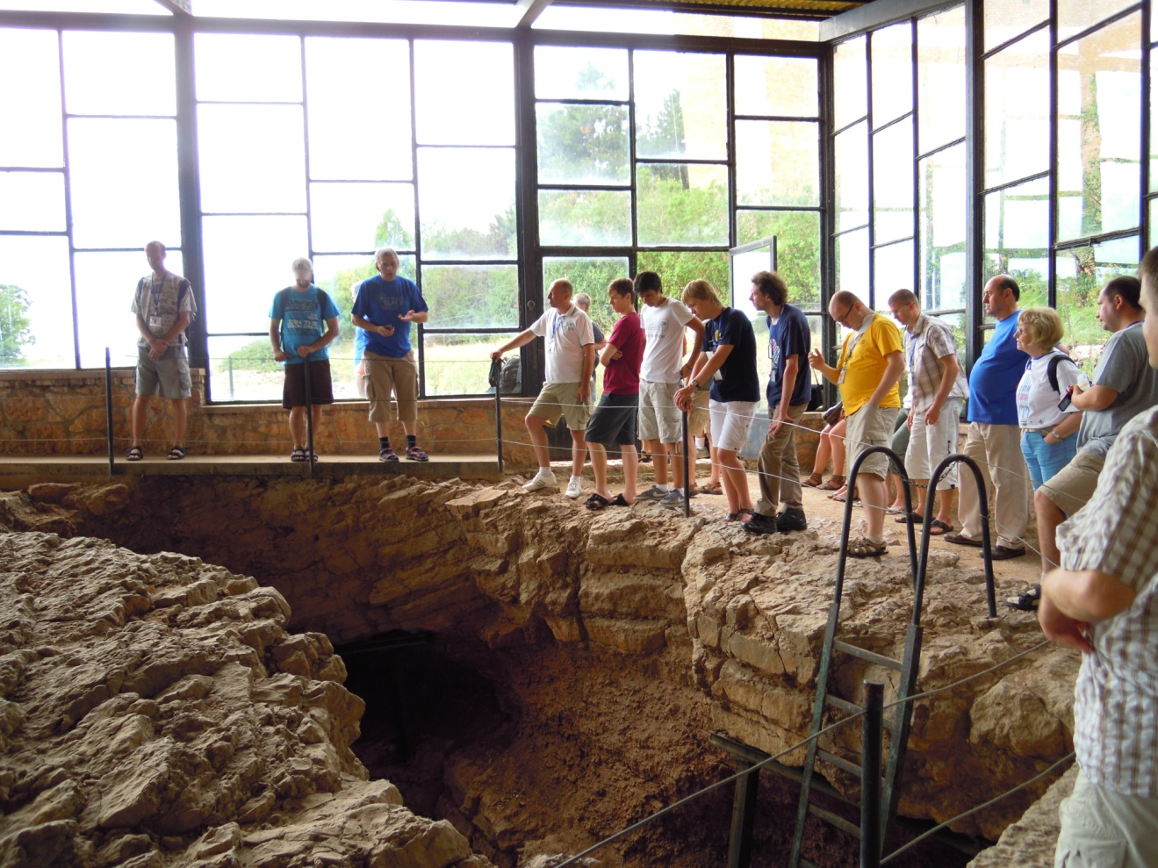
The flintstone cave

Slide 29
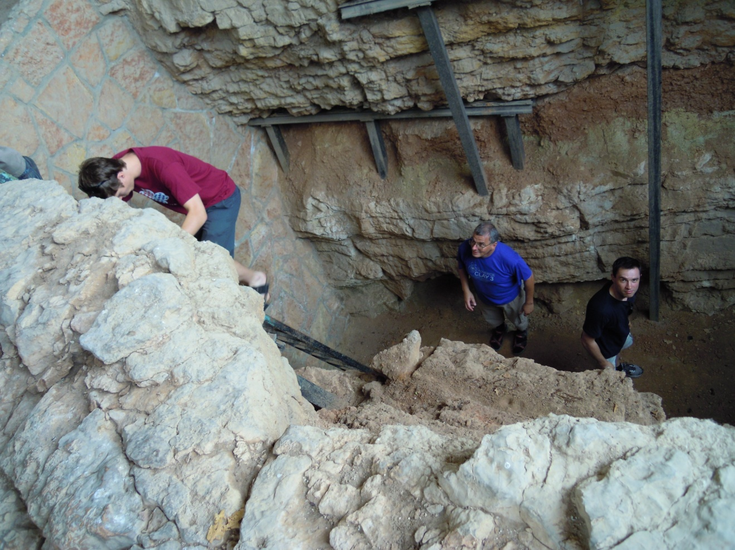
In the cave

Slide 30
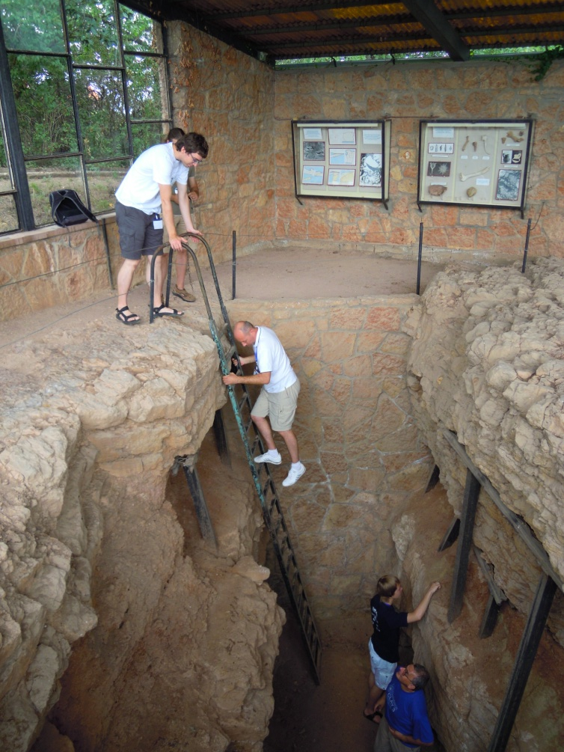
In the cave

Slide 31
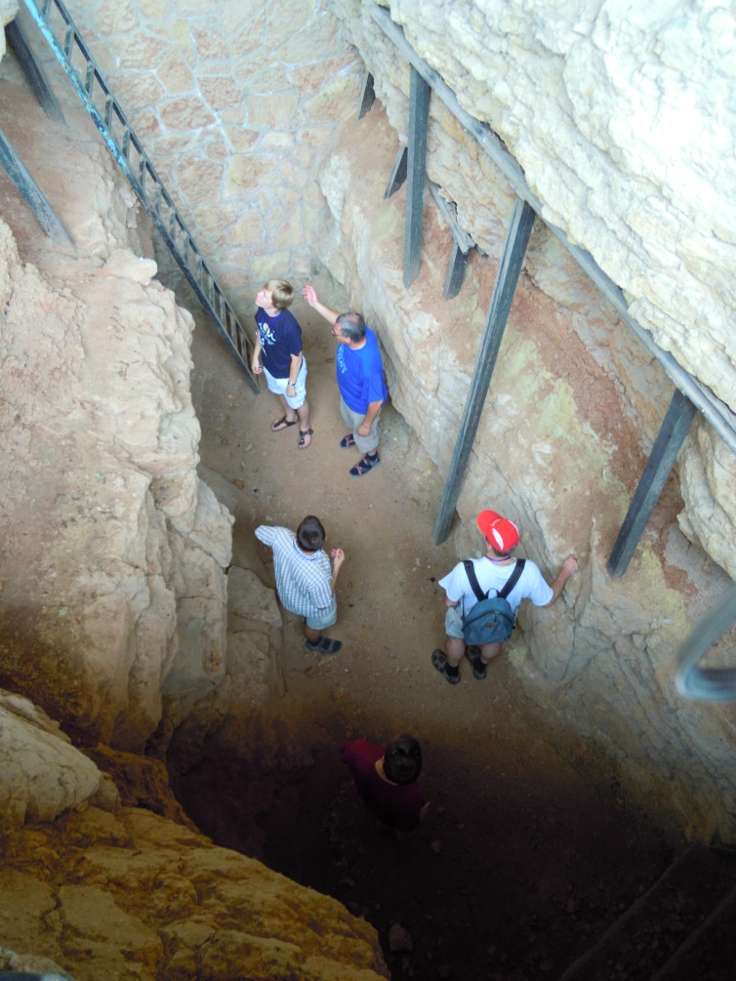
In the cave

Slide 32
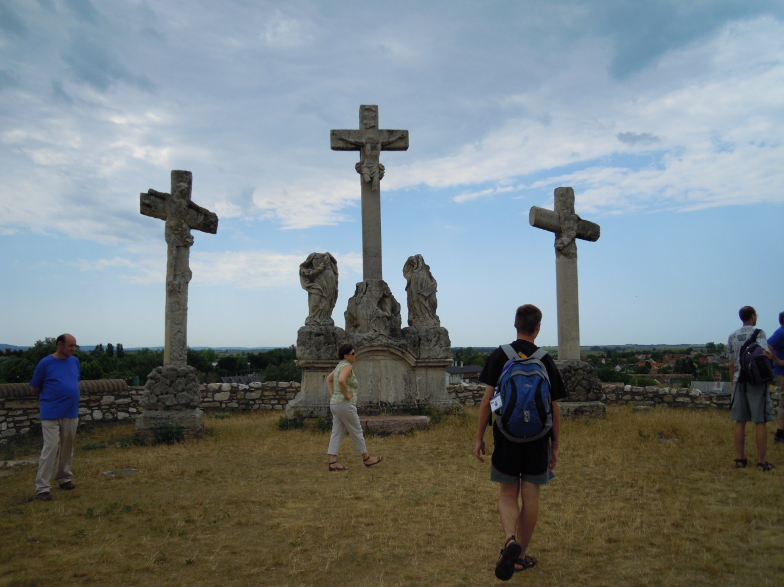
Calvary Hill

Slide 33
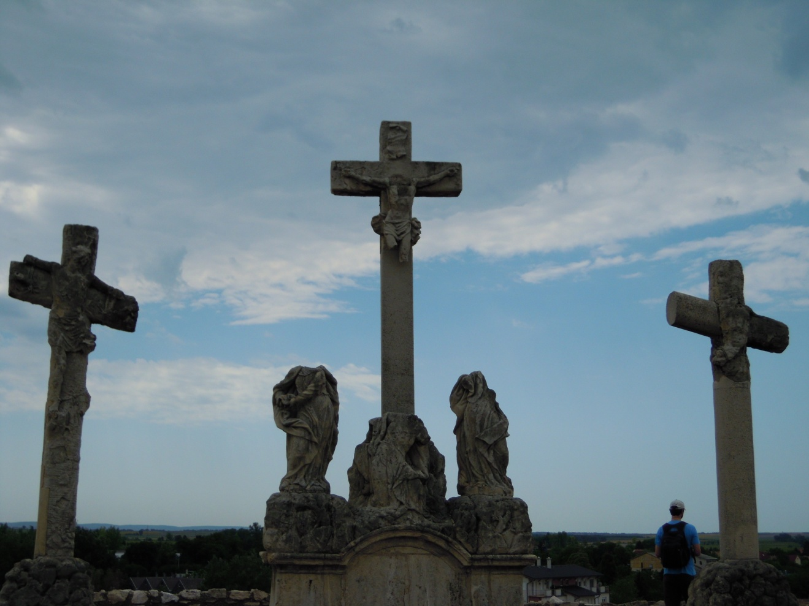
Calvary Hill

Slide 34
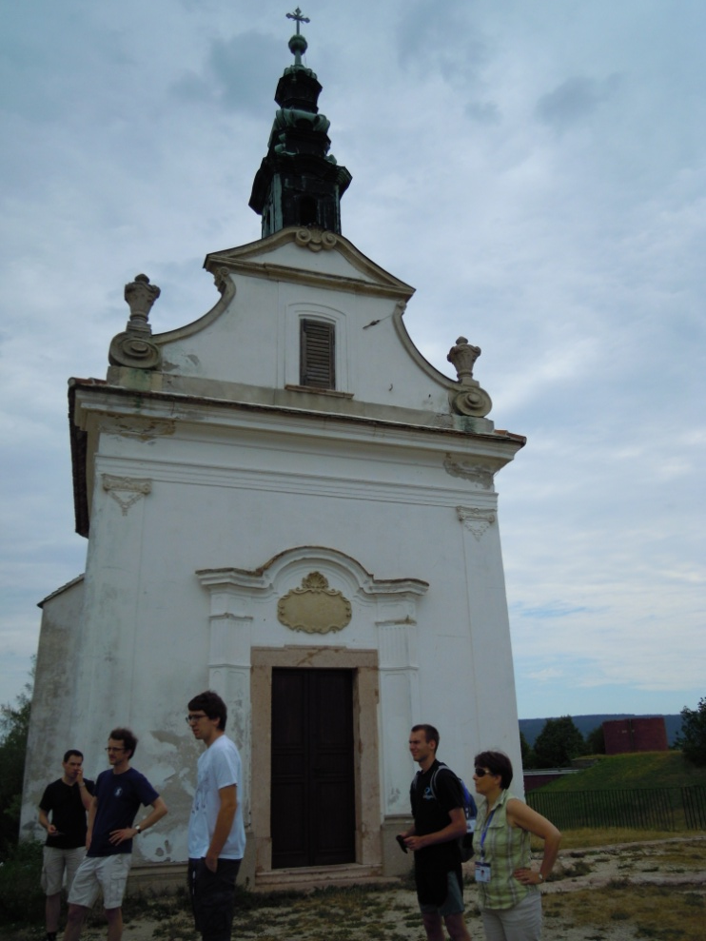
Calvary Hill

Slide 35
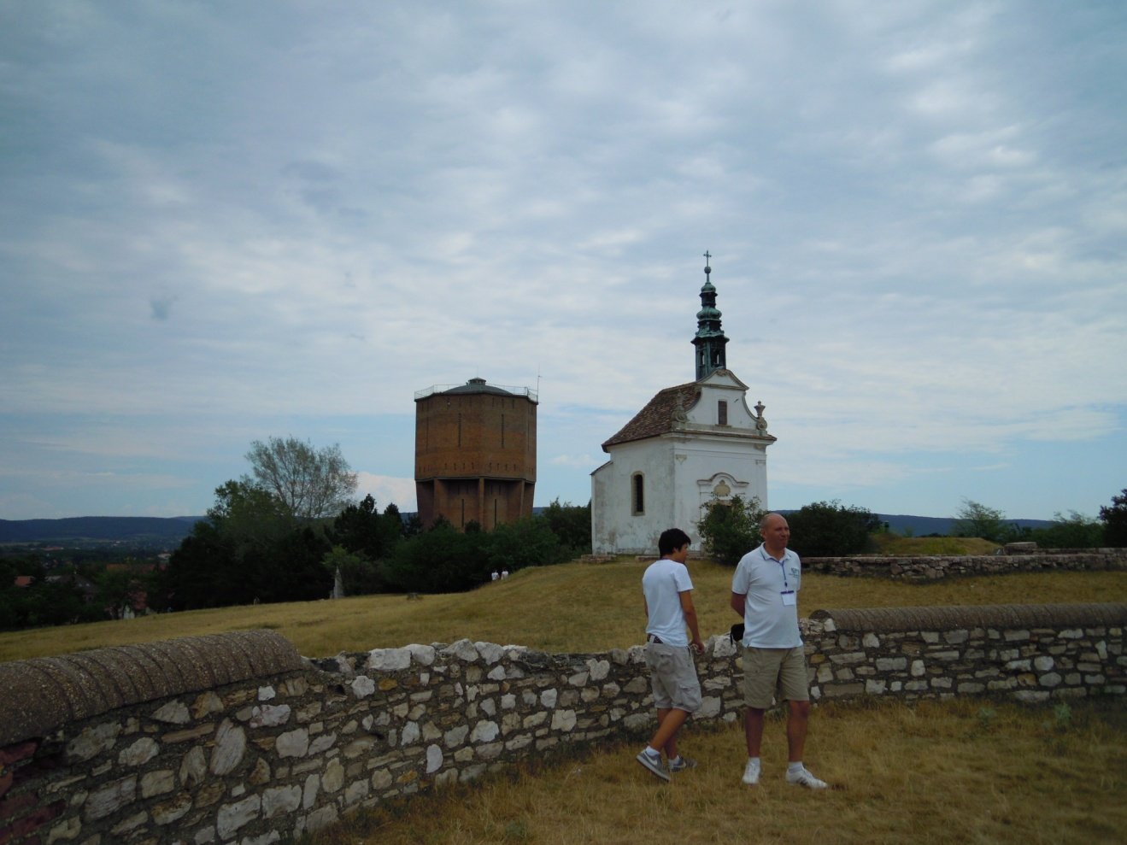
Calvary Hill

Slide 36
Explore Tata
9 July 2012, Monday

Slide 37
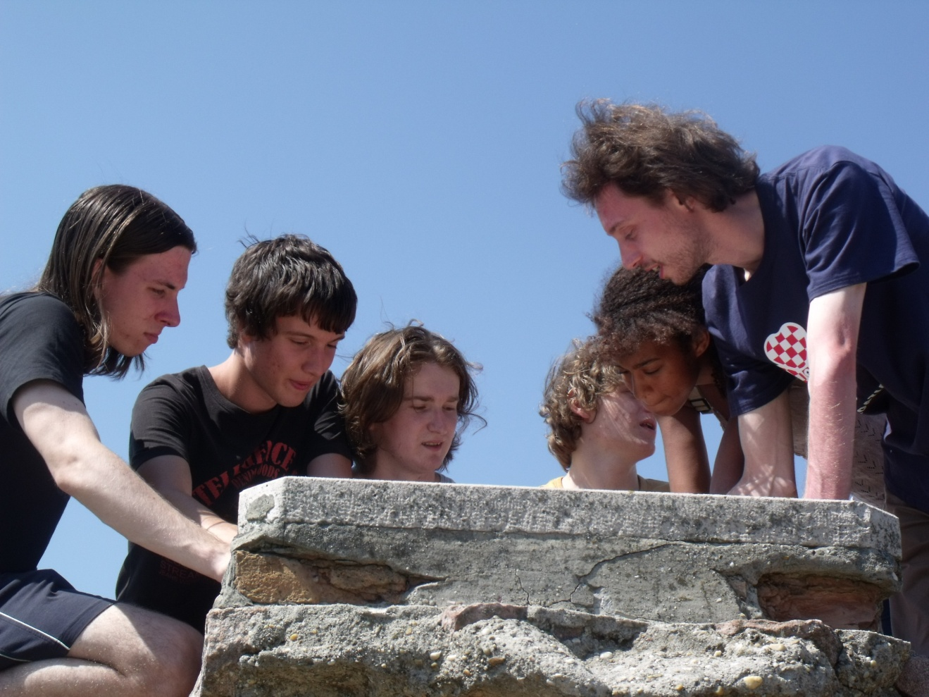
Trying to find the answer

Slide 38
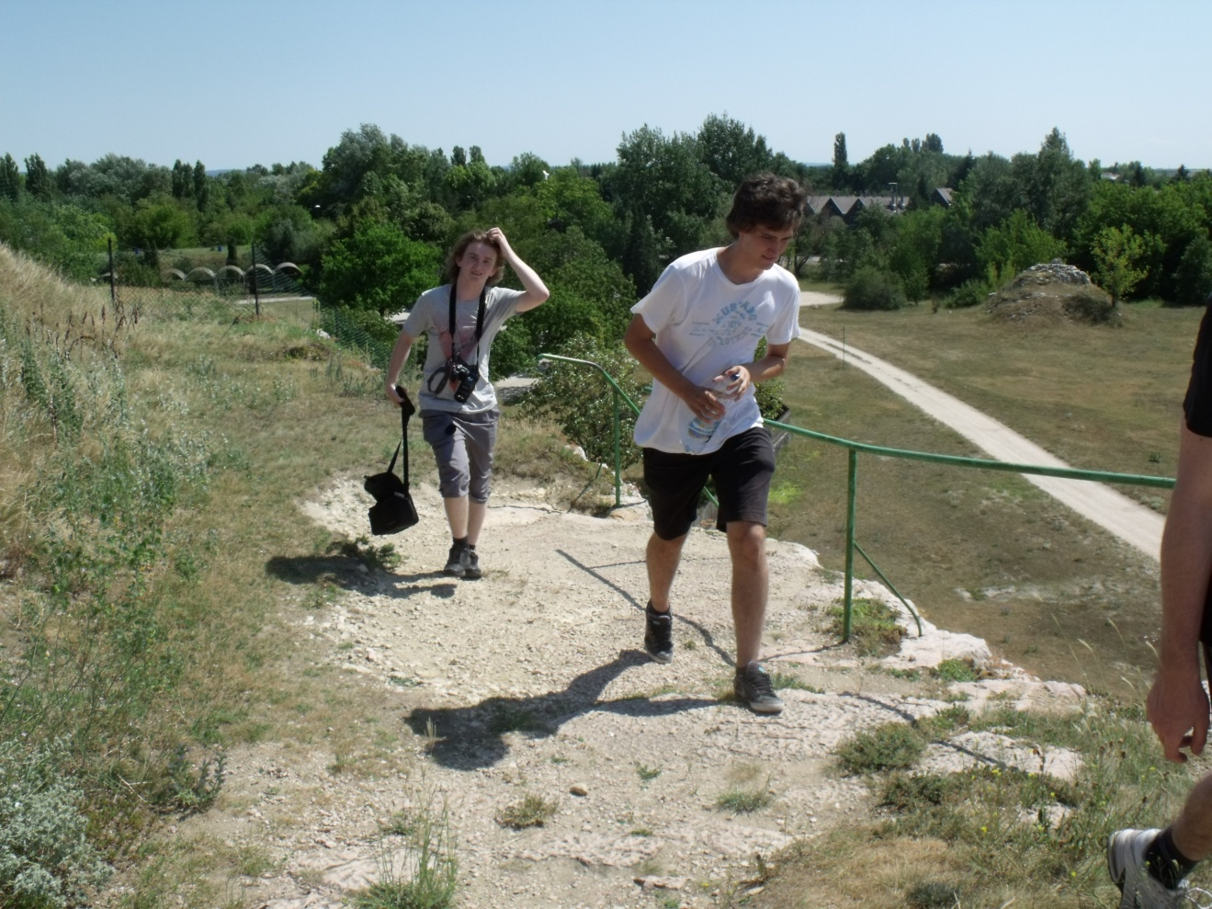
During the exploration

Slide 39
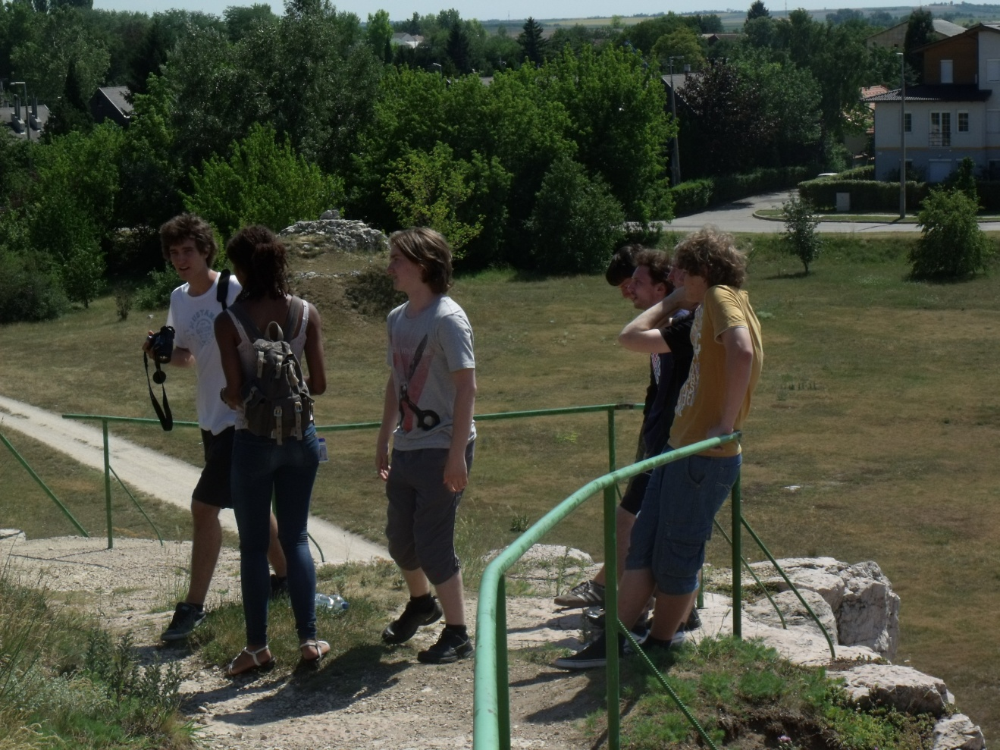
During the exploration

Slide 40
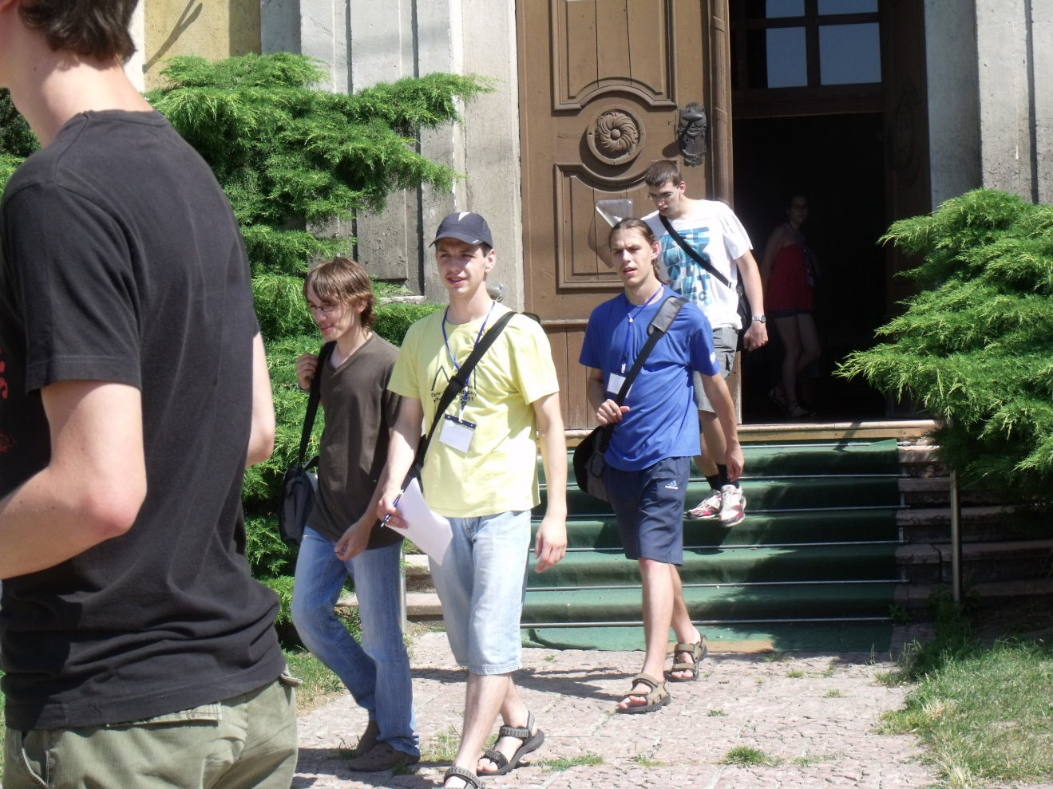
In front of the Great Church

