Slide 1
Closing Ceremony
12 July 2012, Thursday

Slide 2
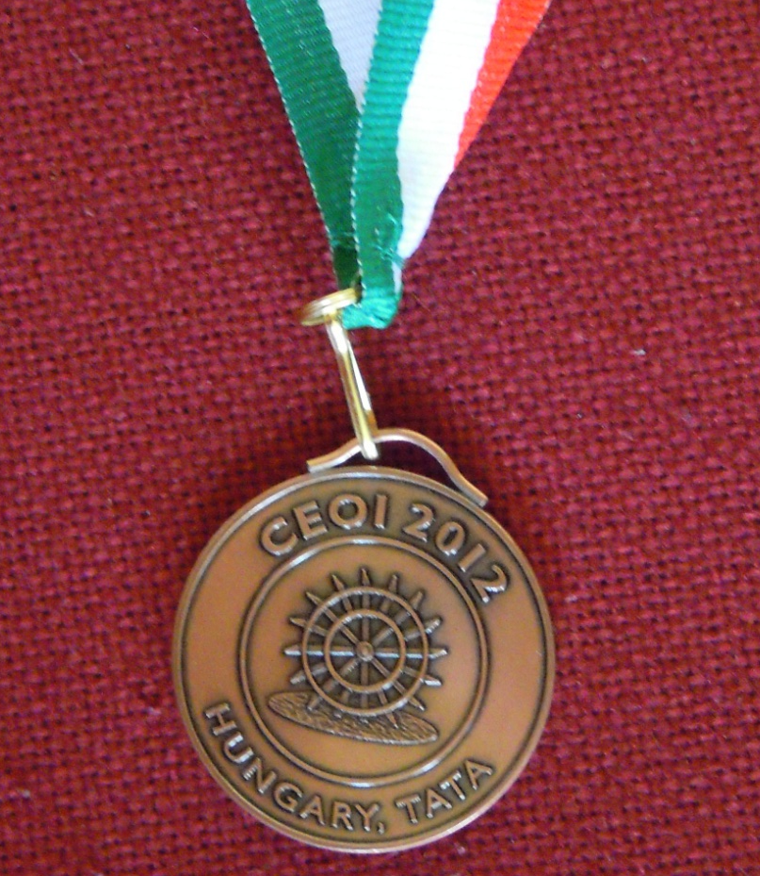
Bronze Medal

Slide 3
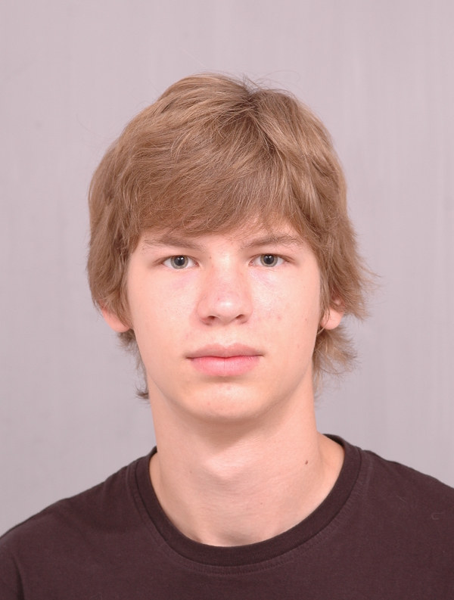

Bronze Medal
Jerguš Greššák
Slovakia

Slide 4
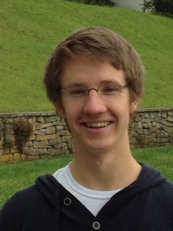

Bronze Medal
Julian Labeit
Germany

Slide 5
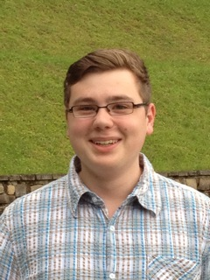
Bronze Medal
Tobias Lenz
Germany

Slide 6
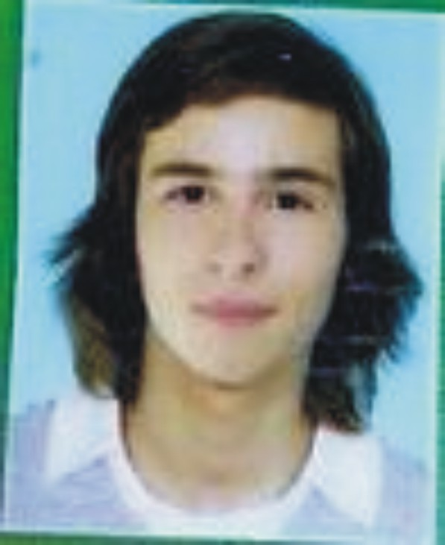
Bronze Medal
Jakub Šafin
Slovakia

Slide 7

Congratulations to the bronze medal winners

Slide 8
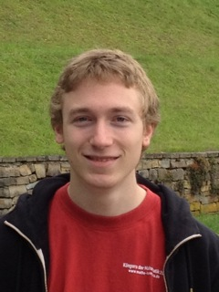
Bronze Medal
Jannes Münchmeyer
Germany

Slide 9
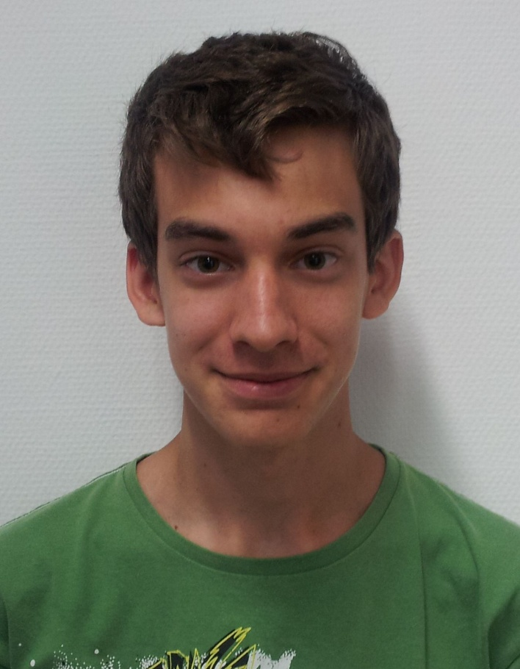

Bronze Medal
Márton Havasi
Hungary

Slide 10
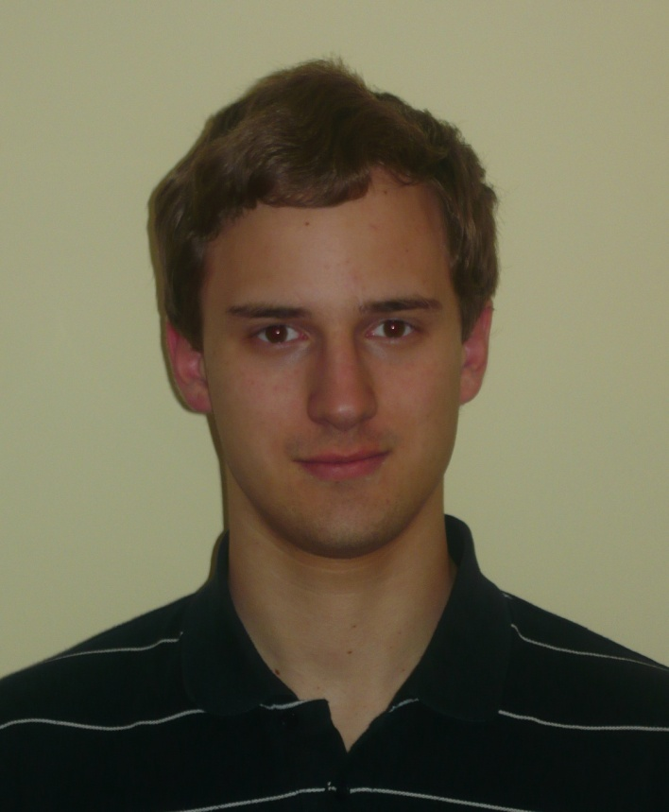
Bronze Medal
Gábor Ferenc Kovács
Hungary

Slide 11
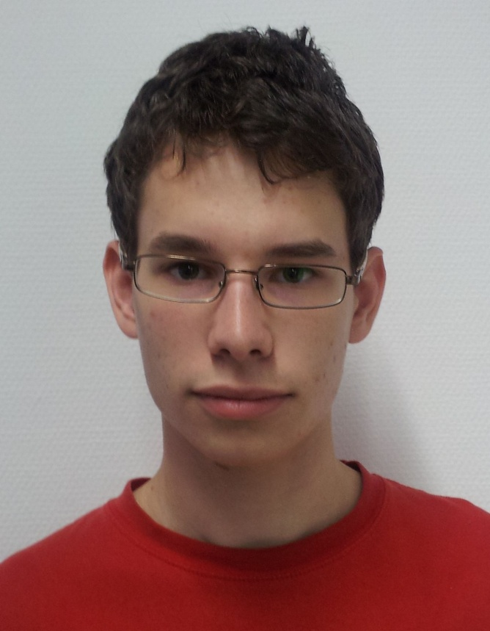
Bronze Medal
Gellért Weisz
Hungary

Slide 12
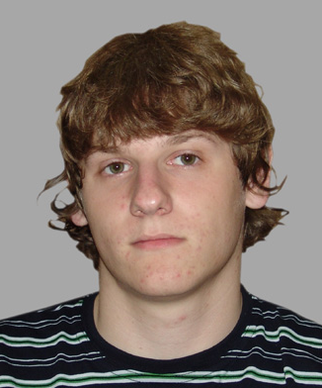

Bronze Medal
Dominik Gleich
Croatia

Slide 13
Congratulations to the bronze medal winners

Slide 14
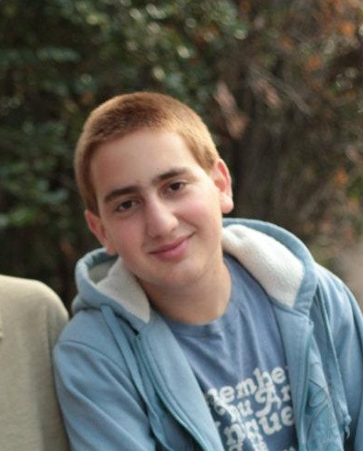

Bronze Medal
Tom Kalvari
Israel

Slide 15

Bronze Medal
Vladimír Macko
Slovakia

Slide 16
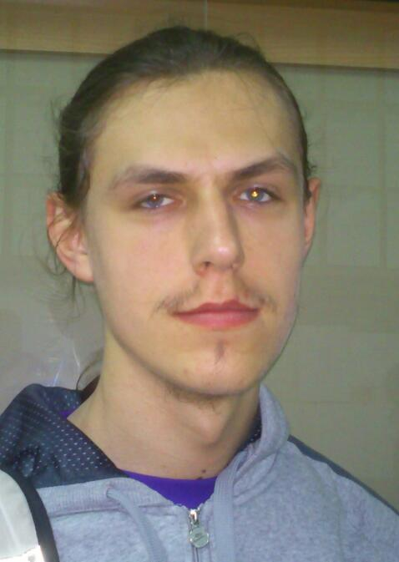

Bronze Medal
Karol Farbiś
Poland

Slide 17
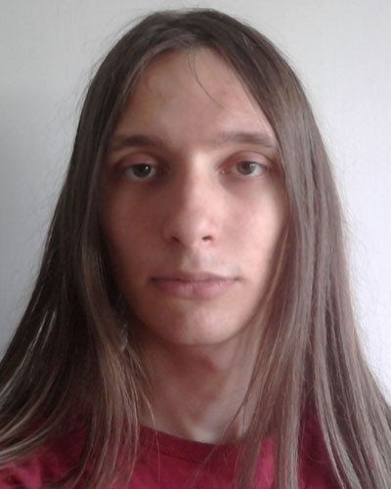
Bronze Medal
Patrik Adrián
Hungary

Slide 18
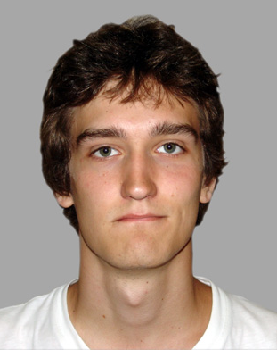
Bronze Medal
Marin Tomic
Croatia

Slide 19
Congratulations to the bronze medal winners

Slide 20
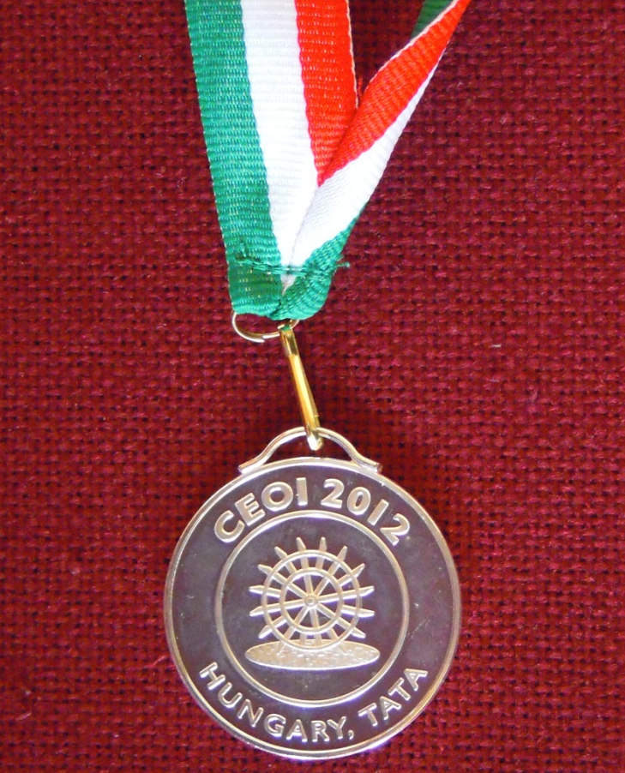
Silver Medal

Slide 21
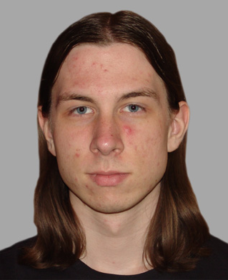
Silver Medal
Tomislav Tunkovic
Croatia

Slide 22
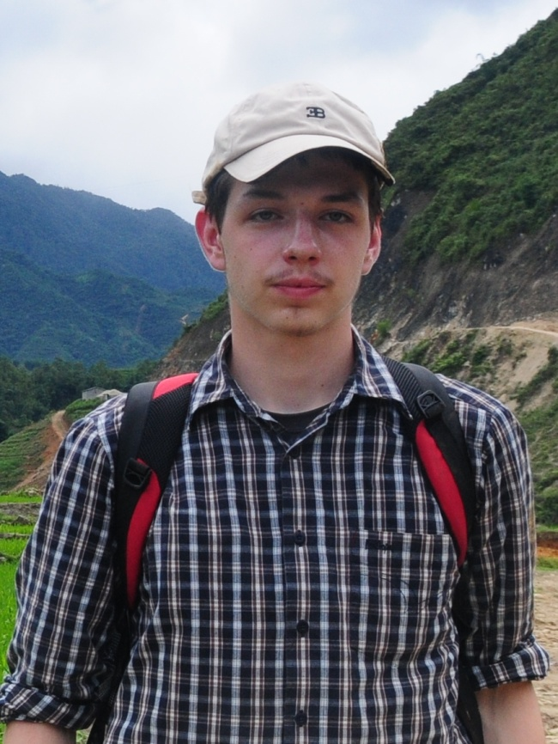
Silver Medal
Bartłomiej Dudek
Poland

Slide 23
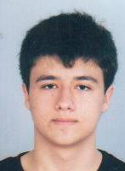

Silver Medal
Georgi
Nikolaev Georgiev
Bulgaria

Slide 24
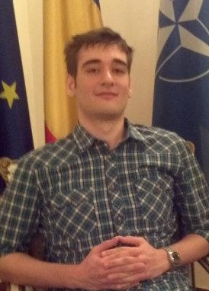

Silver Medal
Şerban
Andrei Stan
Romania

Slide 25
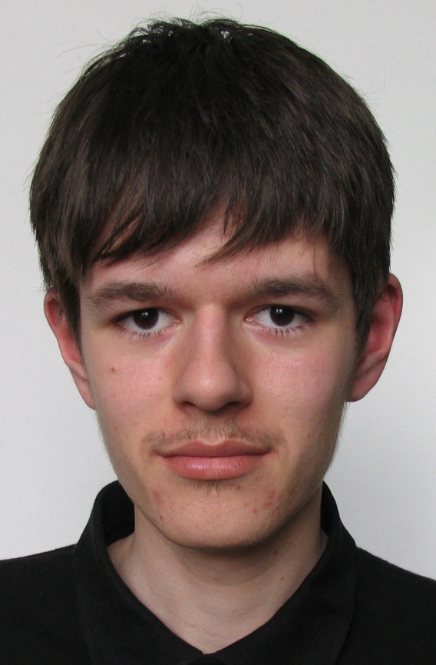

Silver Medal
Martin Raszyk
Czech Republic

Slide 26
Congratulations to the
SILVER medal winners

Slide 27
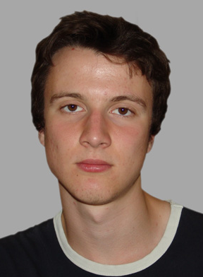
Silver Medal
Antun Razum
Croatia

Slide 28
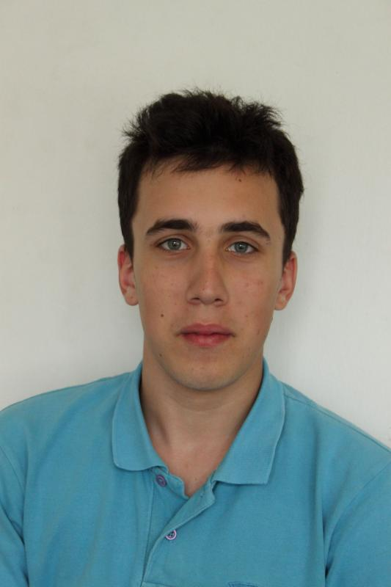
Silver Medal
Balázs Mezei
Hungary

Slide 29
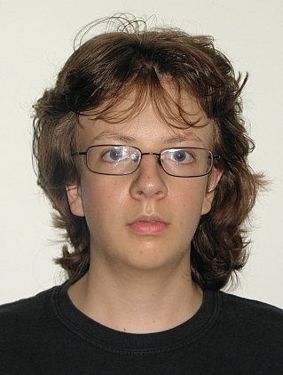
Silver Medal
Hristo
Veselinov Venev
Bulgaria

Slide 30
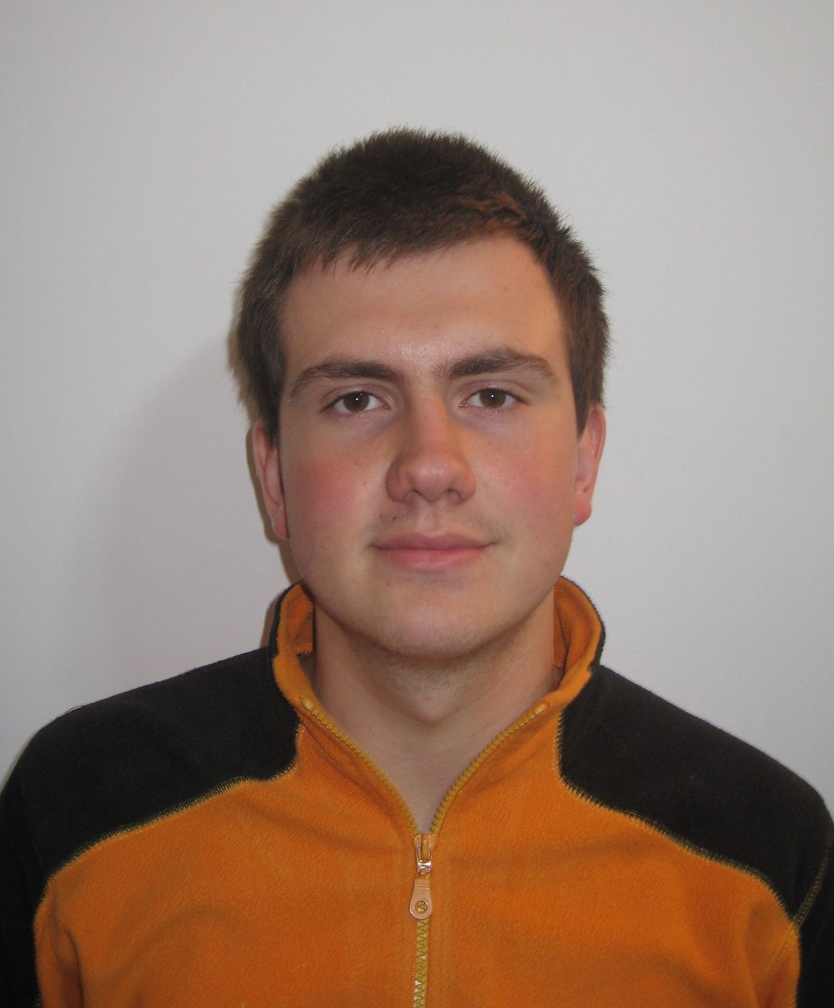
Silver Medal
Andrei Purice
Romania

Slide 31
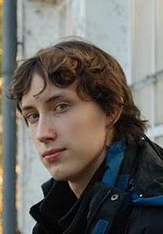
Silver Medal
Wiktor Kuropatwa
Poland

Slide 32
Congratulations to the
SILVER medal winners

Slide 33
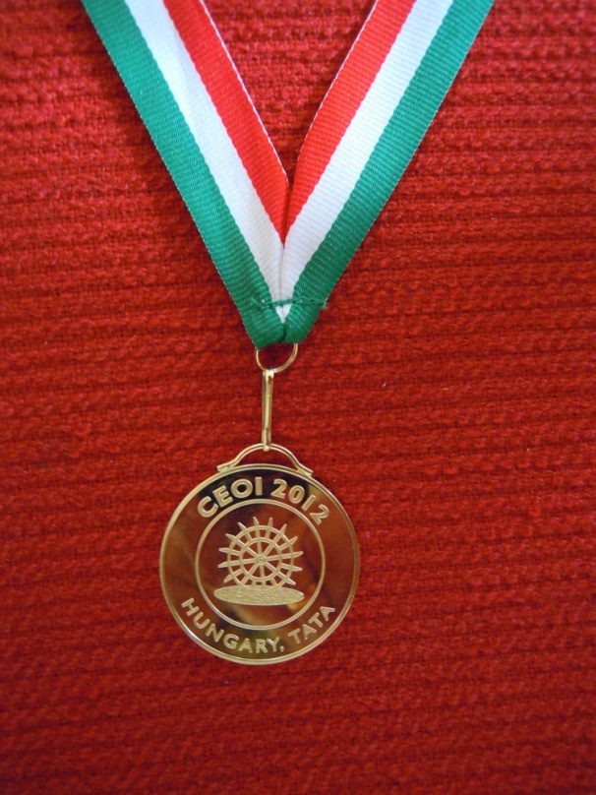
Gold Medal

Slide 34
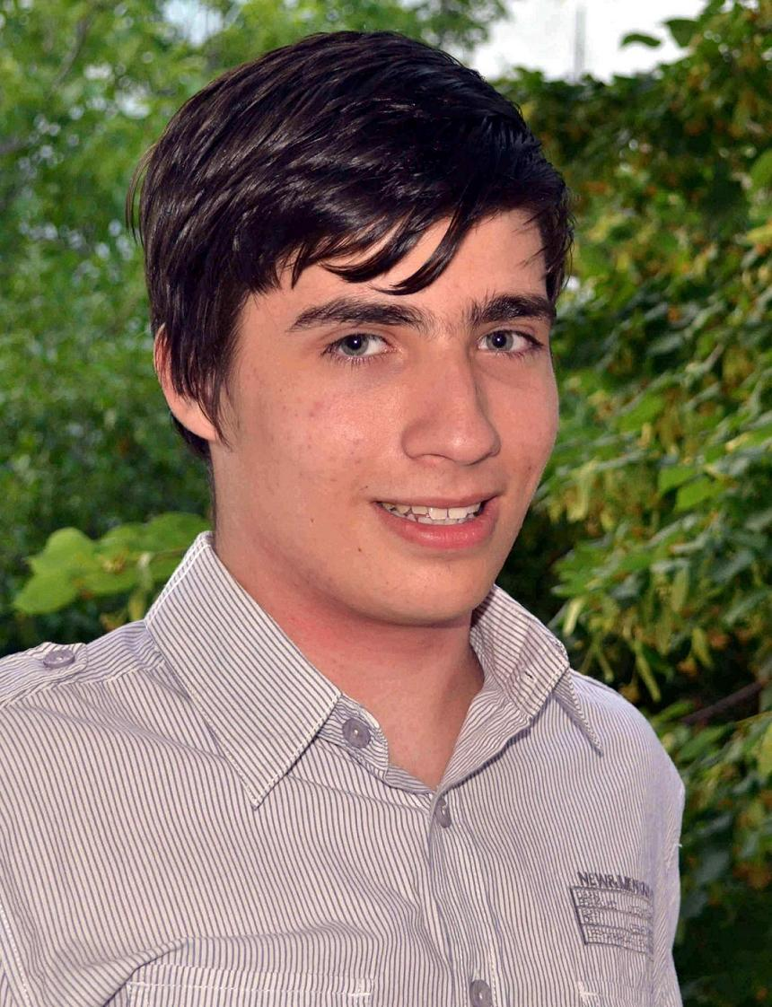
Gold Medal
Vlad
Alexandru Gavrilă
Romania

Slide 35
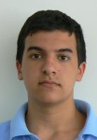
Gold Medal
Rumen
Hristov Hristov
Bulgaria

Slide 36
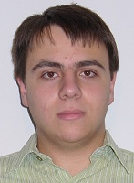
Gold Medal
Yordan
Nikolov Chaparov
Bulgaria

Slide 37
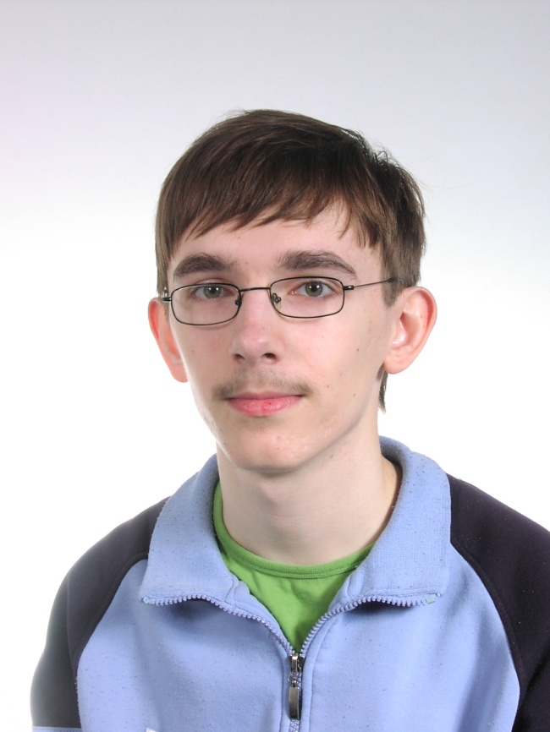
Gold Medal
Mateusz
Gołębiewski
Poland

Slide 38
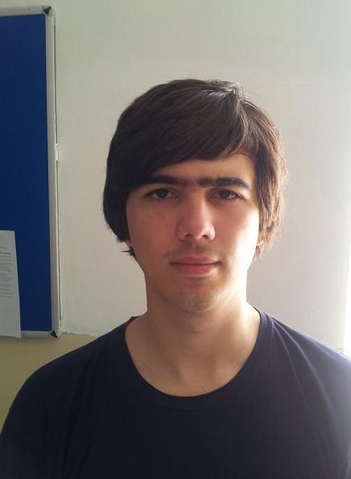
Gold Medal
Adrian Budău
Romania

Slide 39
Congratulations to the
Gold medal winners

